Slide 1
What pediatric practitioners need to know to support parents and patients to prevent on-line sexual victimization
Presented by
the new York state initiative to Prevent
child sexual abuse
February 27, 2024

Slide 2
New York State Initiative to Prevent Child Sexual Abuse
Brought to you by:
The Initiative is dedicated to the prevention of all forms of child sexual abuse throughout the state of New York through advancing research, policy, education and practice. We are organized as a cooperative initiative to provide state-of-the-art theory and research-based knowledge to inform, guide, and empower the public, professionals, and all those who serve children and families at all levels and sectors of society, toward the elimination of child sexual abuse. The Initiative is comprised of leaders in the field of child maltreatment, child protection, and promotion of well-being in children and families.
Learn more about us: https://www.nypreventsexabuse.org/

Slide 3
Your presenters
https://upenn.zoom.us/j/2349276840
https://upenn.zoom.us/j/2349276840
Janet Rosenzweig Ph.D, MPA
Trevor Raushi, M.S.
Author, The Sex-Wise Parent – www.sexwiseparent.com
Executive Committee, The National Coalition to Prevent Child Sexual Abuse and Exploitation www.PreventTogether.org
Original credentials as a sex educator, followed by years in public human services and leading national child welfare NGOs
Assistant Vice President, The New York Foundling's Child Abuse Prevention Program (CAPP) https://www.nyfoundling.org/
Executive Committee, New York State Initiative to Prevent Child Sexual Abuse https://www.nypreventsexabuse.org/

Slide 4
Dangers facing children and youth online
Trevor Raushi

Slide 5
TECHNOLOGY & YOUTH EXPERIENCES
40% of 9–12-year-olds turned to offline support such as a parent, caregiver, or other trusted adult, when they encountered a potentially harmful experience online (Thorn, 2023)
One in three 9–12-year-olds say they consider friends they made online to be some of their closest friends. (Thorn, 2023)
40% of minors have experienced cold solicitations for nudes online, including roughly 1 in 4 (28%) of 9-12-year-olds. (Thorn, 2023)
One in four 9-12-year-olds see it as normal for kids their age to date adults aged 18-20. (Thorn, 2023)

Slide 6
NY STUDENT EXPERIENCES
Male, Age 8, September 2022
Child stated that while playing the game Fortnite, a user he didn’t know asked him to send “inappropriate things” to him. Child stated the user asked him to call him “Daddy” and said “inappropriate” things to him. The child told his Mom and then his Mom blocked the user. Child hasn’t been allowed to play Fortnite since.
Female, Age 8, October 2022
Child stated she was playing Roblox when she was put into a chat where there was, “a lot of inappropriate stuff and a lot of men.” The child was asked for her email and address. Child stated she was “teleported to a very weird place.” The child informed her mom about this and has made a new Roblox account.
Male, Age 9, November 2022
Child disclosed that “while I was playing my video games last night, I was waiting for my friends to join and then a user I didn’t know invited me to play with them." Child stated, “I went to play and then the gamer started messaging me and asking me random questions”. Child added that “the person was asking me how old I was and where I live’. The child told the user what they were asking was “TP” which the child explained means “too personal”. The child stated he left the game and went back to waiting for his friends.

Slide 7
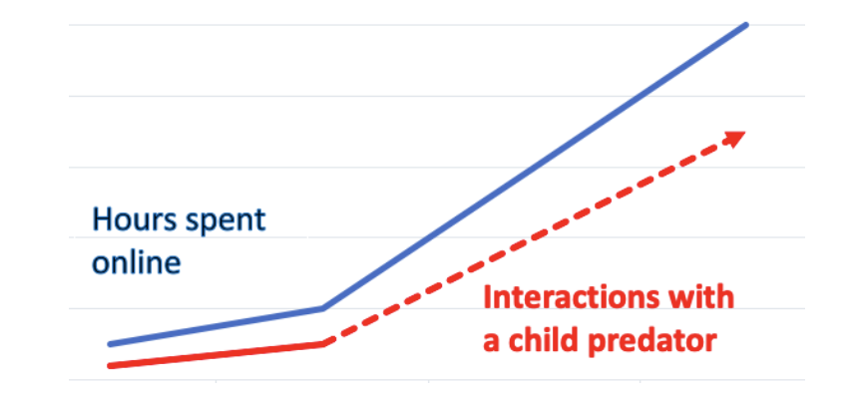
Identifying the Problem/Statistics
Tips to the National Center for Missing and Exploited Children nearly doubled between 2019 and 2020
The majority of online sexual advances toward children occur in the chat feature of a game or social media app.
Some of these games have built-in privacy settings and content restrictions; those only block so much
Notes:
https://www.purevpn.com/blog/dangerous-social-media-apps/

Slide 8
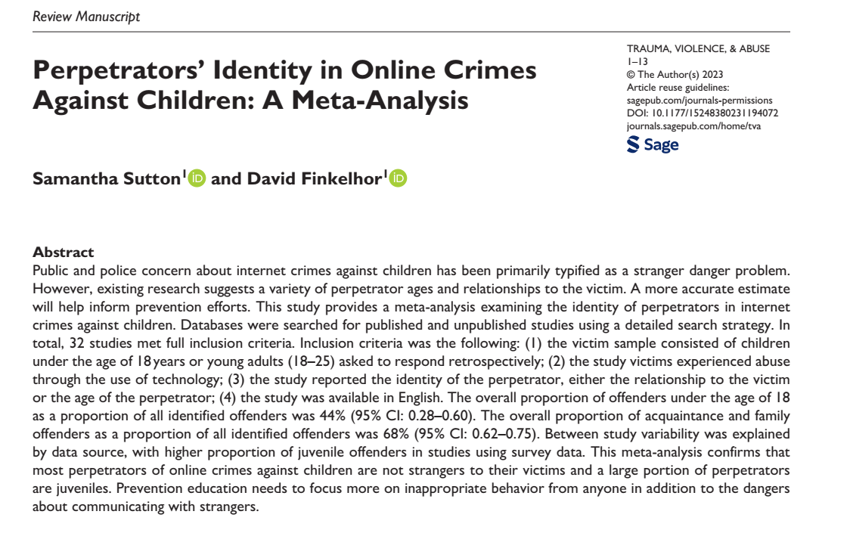
Current research shows that the majority of victimization comes from peers~
This meta analysis of 32 police and survey studies shows that 68% of online offenders against children are acquaintances and family members. 44% of offenders are themselves juveniles. Excluding police samples the juvenile offenders are 63%.
The stereotype of the adult stranger perpetrator does not represent the true diversity of the problem of online crimes against children.
(NCMEC counts officials reports, this study is retrospective interviews)

Slide 9
Understanding sextortion Janet Rosenzweig
NCMEC defines it as “a form of child sexual exploitation where children are threatened or blackmailed, most often with the possibility of sharing with the public nude or sexual images of them, by a person who demands additional sexual content, sexual activity or money from the child.”
Sextortion cases have doubled between 2019 and 2021, and teenage boys are the most common targets, according to NCMEC.
Victims have committed suicide rather than face their families and communities
Predators use a child's sexual arousal to trap them

Slide 10
Call to action!
The most damaging impact of ‘sextortion’ of any kind is the shame felt by the victim when they are exposed
Shame and humiliation are as damaging to a teen as physical abuse
Set a norm for your family – which will impact your community -- that we empathize with victims, and NEVER shame them.
Encourage schools, youth services agencies and other places serving children and youth to do likewise

Slide 11
Strategies for parents
1) Accurate information about human sexuality

Slide 12
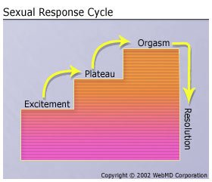
Physical Facts with Emotional Impact Fact 1:
The human body will react to various kinds of stimulation with very specific physical manifestations

Slide 13
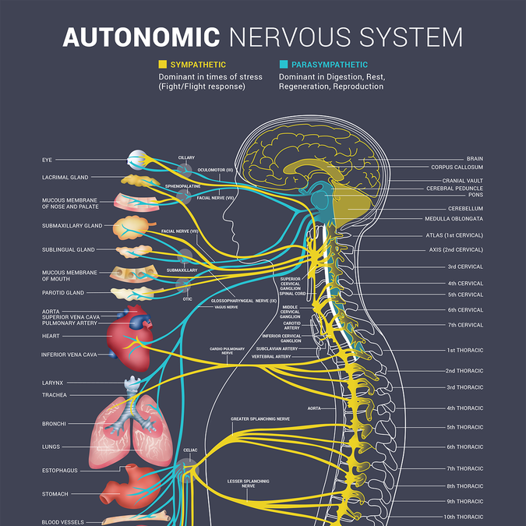
Physical Sexual Arousal
The Autonomic Nervous System:
The part of the nervous system responsible for control of the bodily functions not consciously directed, such as breathing, the heartbeat, and digestive processes.

Slide 14
Key words!
not consciously directed, such as breathing, the heartbeat, and digestive processes.
Physical sexual arousal is an autonomic response

Slide 15
Key reasons why kids need to know this
Victims may experience a physical, sexual/genital response while being victimized
Predators may use the response against them, convincing the child they are a willing participant because they ‘enjoyed’ the act.
Notes:
Add the issue of same gender abuse – concision about sexuality

Slide 16
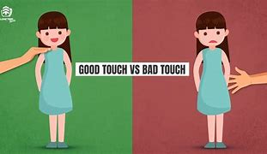
Key reasons why kids need to know this
Victims may experience a physical, sexual/genital response while being victimized
This is wildly confusing for children who have experienced sexual abuse prevention education as only ‘good touch/bad touch’
Notes:
Add the words from an adult victim who thanked me

Slide 17
Key reasons why kids need to know this
Kids may confuse a physical/genital sexual response for an emotional attachment, making them vulnerable to predators.
Adolescents and teens are particularly vulnerable.
Physical sexual arousal decreases sexual self restraint.
Physical sexual arousal may lead a victim to believe they participated in a sinful/forbidden act, unnecessarily adding to guilt and confusion.
Notes:
Add the words from an adult victim who thanked me

Slide 18
Account from a victim
Child TV star describes being molested by his publicist:
“Pull your pants down,” he said.
I didn’t want to lose everything he had given me. And so I did.
He put his mouth on me. I got hard. I didn’t know where to look or how to feel. I squirmed against the back of the seat. He kept on going, getting into it.
I hoped it would be over fast.
Then it happened. I came.
As confused and upset as I was, I liked the feeling.
“No one had ever talked to me about sex before, but somehow I knew it was wrong for a man to do that to a boy. I was really confused because having an orgasm had felt good.”
Bridges, Todd with Sarah Tomlinson. Killing Willis. New York: Simon and Schuster, 2010. Page 68

Slide 19
Key reason why parents need to know this
It is unhealthy to raise children who learn to associate negative emotions with their sexual/genital arousal
Fear, guilt and shame have no place in sexual health and safety
At best, these negative emotions interfere with healthy age-appropriate sexual relationships
At worst, a child can grow into someone who needs these negative emotions to experience sexual arousal

Slide 20
Let’s go back to Psych 101 for a moment:
Operant conditioning is a learning method in which a specific behavior is associated with either a positive or negative consequence. Thus, this form of learning links the taking of certain voluntary actions with receiving either a reward or punishment, often to strengthen or weaken voluntary behaviors.
Think BF Skinner....
Classical conditioning is a learning process focused more so on involuntary behaviors, using associations with neutral stimuli to evoke a specific involuntary response.
Think Pavlov…..

Slide 21
Strategies for parents
2) Understanding the on-line environment and its threats to children and youth

Slide 22
Educate
Parents/caregivers may take the step to educate themselves first:
Search online for articles about kids and social media - read and learn!
Talk to other parents about their experiences.
Try out some of the apps and then talk to their own child about how they are using that app.
Parents/caregivers may then feel more comfortable educating their children:
Use correct anatomical terms when referring to all body parts.
Talk about risks affiliated with sharing personal information & photos online. Use real-life examples from the news & media.
Set up a system to monitor their child and let them know you are doing just that.
Encourage their child’s school to help educate kids about social media use.

Slide 23
Communicate
Emphasize the importance of communication to parents/caregivers...
Make communication a priority
Research shows that only 25% of children who receive online sexual solicitation tell a parent/caregiver
One of the best things parents can do is ensure their child feels comfortable talking to them if they are ever approached in person or online
Never too soon to begin having these conversations
Hey, what's the deal with this Roblox game you like so much? How does it work?
I play games with friends, dress-up my avatar, and collect tokens!

Slide 24
Help
Parents/caregivers should strive to be seen as the primary "helper" for their child...
It is important for your child to understand that if they are ever in an unsafe or dangerous situation, they can come to you for help.
Tell your child if they get in trouble, you will help them and stand by their side.
Tell your child that if a friend is in trouble, to tell you or another adult.
Teach your child to report to an adult inappropriate images and posts, and to never, ever repost or forward them.
REMEMBER!
ONLINE PREDATORS WILL COUNT ON A CHILD'S FEAR AND HESISTATION TO ASK THEIR PARENT/CAREGIVER FOR HELP

Slide 25
observe
Parents/caregivers are urged to observe their child's behavior...
Closing down the computer in your presence
Not wanting to let you look at their phone
Sleep deprivation signs (dark circles under the eyes, falling asleep at odd times)
Social isolation
Refusal to communicate with you
Skittishness
Changed passwords or suddenly deleted accounts
REMIND PARENTS & CAREGIVERS
TO CONSIDER THAT A CHANGE IN THEIR CHILD'S BEHAVIOR, MOOD, OR ATTITUDE COULD BE CAUSED BY AN ONLINE INTERACTION OR RELATIONSHIP

Slide 26
E.C.H.O. Review
Educate:
Parents/caregivers should educate themselves on these topics before educating their children
Parents may explain to their child about privacy and protecting their identity by not disclosing their name, address, present location, school they attend, or phone number when online.
Communicate:
When supporting parents, emphasize the importance of communication with their children
Parents can try to engage their children in discussions about what they view/do online so that they are able to share both their negative and positive experiences. Parents should want to build trust with their child.
Help:
It is important for parents to be willing to help their child should they run into a problem online.
Establish a supportive environment so the child feels safe going to their caregiver when they are in need of help.
Observe:
Observing any changes in behavior from your child can help you determine if there is something wrong.
There are common behaviors that indicate that there is abuse occurring.
Notes:
https://www.beaubidenfoundation.org/resources/electronic-device-agreement/
Step-By-Step Instructional Video Tutorial for TikTok Parental Control Settings:
(Click Here To Play Video)
** Video not yet created

Slide 27
Modeling "E.C.H.o." For parents/caregivers Auditory learning Clip
NEGATIVE PARENTAL RESPONSE
POSITIVE PARENTAL RESPONSE

Slide 28
How to block/report on popular apps Video Tutorial: TikTOk
Watch: Safety Setting Tutorial for TikTok

Slide 29
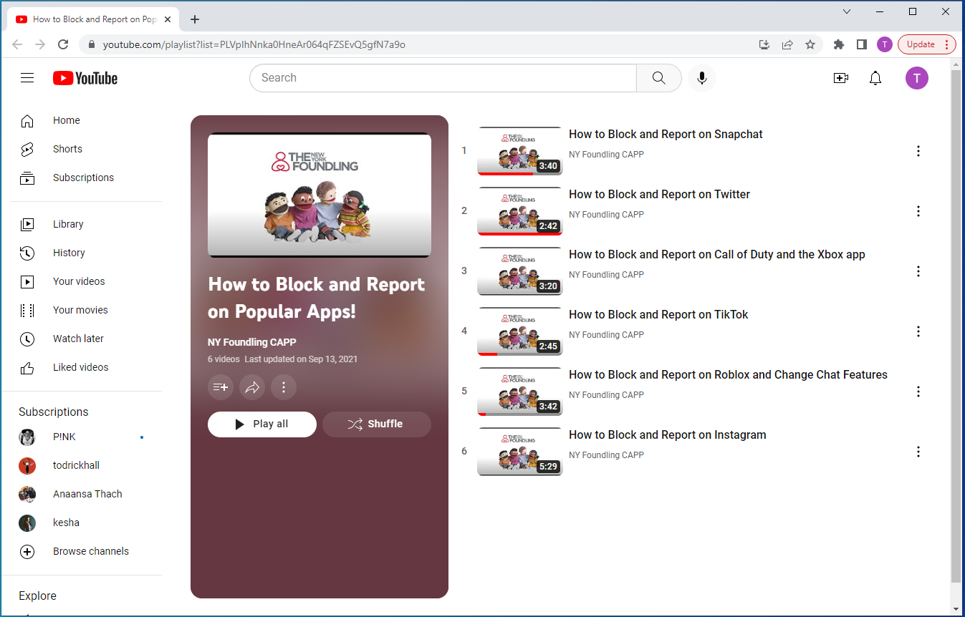
How to block/report on popular apps Video Tutorials
https://www.youtube.com/watch?v=_CG0idm3F7E&list=PLVpIhNnka0HneAr064qFZSEvQ5gfN7a9o

Slide 30
if a child is contacted online what to do...
Guidelines from Department of Homeland Security
If you suspect your child has been approached by an online predator and there has been a history of communication:
Do not block/delete any information or account from the device.
Ask your child for any passcodes
Put the device on airplane mode (To block all network connections)
Call law enforcement
Nation Center for Missing & Exploited Children Cyber Tipline: https://report.cybertip.org/
Notes:
https://www.beaubidenfoundation.org/resources/electronic-device-agreement/
No data of the online predator contacting your child if you delete or block. You may see the chat but cannot identify the user.

Slide 31
Resources
For prevention and intervention

Slide 32
a child’s images are shared on-line what to do
https://Takeitdown.ncmec.org They will also serve adults whose images were shared before they were 18
Notes:
https://www.beaubidenfoundation.org/resources/electronic-device-agreement/
No data of the online predator contacting your child if you delete or block. You may see the chat but cannot identify the user.

Slide 33
a child’s images are shared on-line what to do
Internet Crimes Against Children Task Force (maryland.gov)
https://mdsp.maryland.gov/Organization/Pages/CriminalInvestigationBureau/CriminalEnforcementDivision/Internet-Crimes-Against-Children-Task-Force.aspx
Notes:
https://www.beaubidenfoundation.org/resources/electronic-device-agreement/
No data of the online predator contacting your child if you delete or block. You may see the chat but cannot identify the user.

Slide 34
resources
For medical practitioners to use and share with families!

Slide 35
How can we help parents do better?
Put information where parents will find it
The internet has not killed pamphlets!
See what the AAP has to say about healthy sexual development
https://www.healthychildren.org/English/safety-prevention/at-home/Pages/Sexual-Abuse.aspx
https://www.healthychildren.org/English/ages-stages/gradeschool/puberty/Pages/Talking-to-Your-Child-About-Sex.aspx
https://www.healthychildren.org/English/family-life/Media/Pages/multiplayer-games-online-how-to-help-keep-kids-safe.aspx

Slide 36
New!!! From the NY State Initiative to
Prevent Child Sexual Abuse!
The Initiative is dedicated to the prevention of all forms of child sexual abuse throughout the state of New York through advancing research, policy, education and practice. We are organized as a cooperative initiative to provide state-of-the-art theory and research-based knowledge to inform, guide, and empower the public, professionals, and all those who serve children and families at all levels and sectors of society, toward the elimination of child sexual abuse. The Initiative is comprised of leaders in the field of child maltreatment, child protection, and promotion of well-being in children and families.
Learn more about us here: https://www.nypreventsexabuse.org/
t

Slide 37
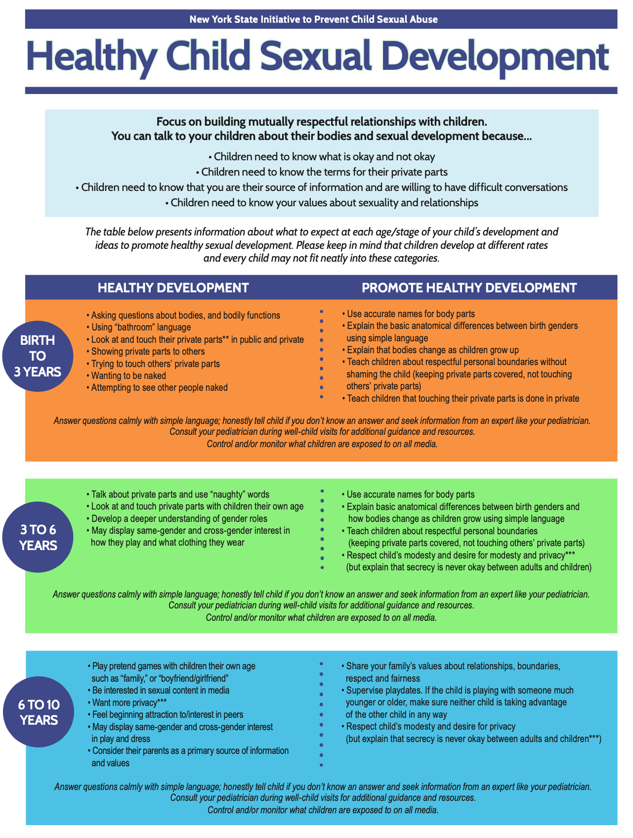
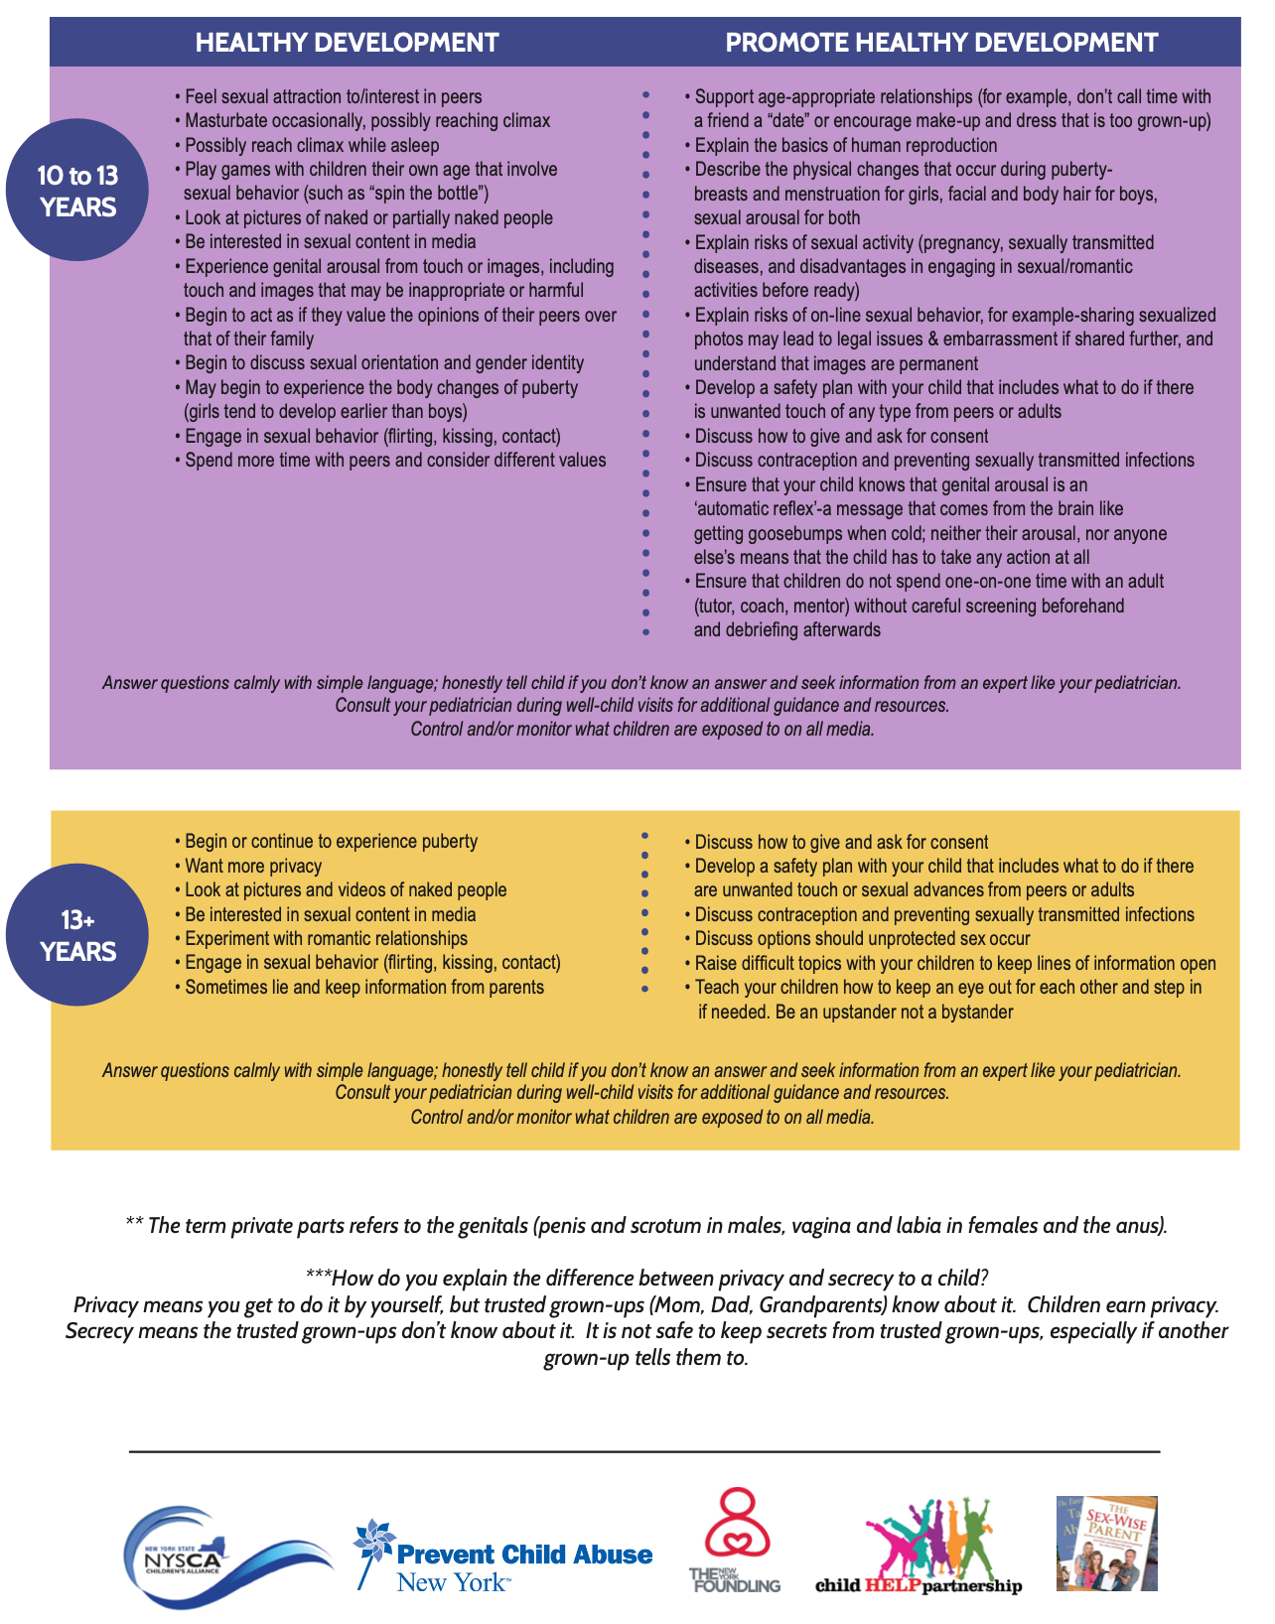
Healthy sexual development tips & talking points for parents & Caregivers

Slide 38
Link to retrieve PDF
Healthy Sexual Development | Nysipcsa (nypreventsexabuse.org)
https://www.nypreventsexabuse.org/healthy-sexual-development

Slide 39
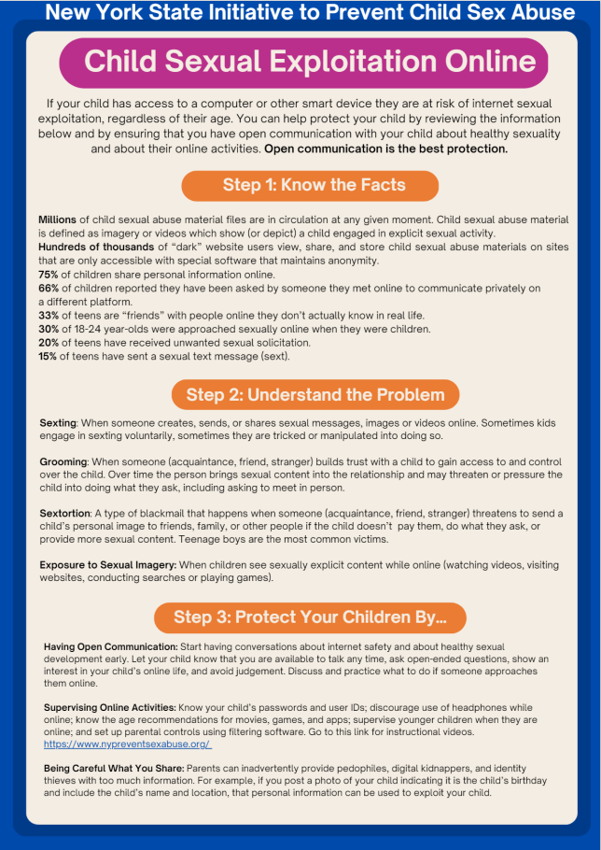
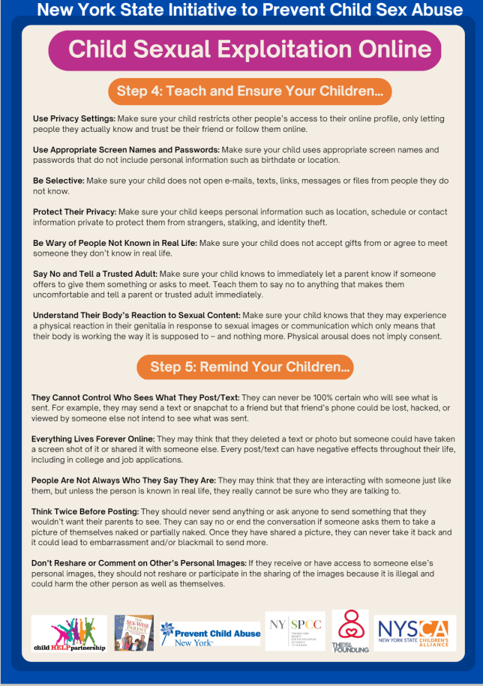
Child sexual exploitation online tips & talking points for parents & Caregivers

Slide 40
Link to retrieve PDF
Information for Youth | Nysipcsa (nypreventsexabuse.org)
https://www.nypreventsexabuse.org/information-for-youth
https://www.nypreventsexabuse.org/copy-of-healthy-sexual-development-1 (for parents)

Slide 41
The medical community can promote sexual health and safety -- support parents as their children primary sex educators!
Advocate for resources in faith based, health and community organizations to support parents to become the primary sex educators of their children

Slide 42
Link to retrieve PDF
Resources | The Sex-Wise Parent (sexwiseparent.com)
WWW.SexWiseParent.com/resources

Slide 43
A National Plan to Prevent Child Sexual Abuse and Exploitation
Notes:
Prevent Together has developed a National Plan to Prevent Child Sexual Abuse and Exploitation to provide a framework for effective, comprehensive, and holistic prevention interventions that are culturally sensitive, include survivor and marginalized voices, strengthen child-friendly environments for collective impact, and act as a catalyst for social change for protecting children from sexual abuse and exploitation.
First national plan published in 2008 with six key action areas to promote prevention
Updated in 2012 and again in 2021.

Slide 44
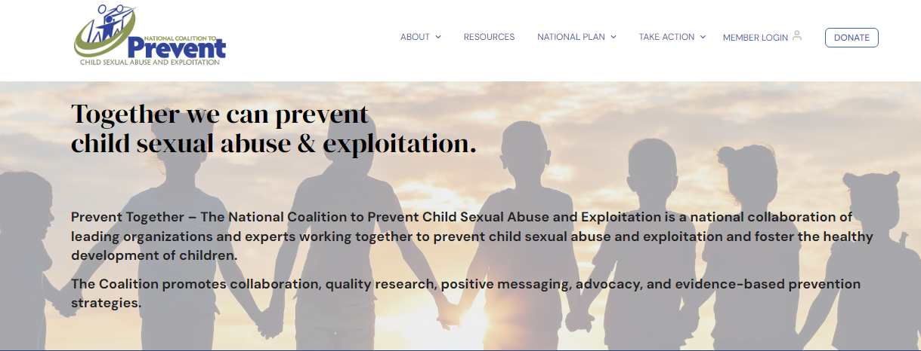
READ THE Plan - Join the National Coalition
WWW.PREVENTTOGETHER.ORG
SCAN HERE
WWW,Preventtogether.org
PreventTogether@gmail.com
www.PreventTogether.org
TO VISIT
THE NATIONAL
COALITION TO PREVENT CHILD SEXUAL ABUSE AND EXPLOITATION​
Notes:
QR code goes directly to the National Plan on the website. You can also provide your contact information.

Slide 45
Thank you!!
For resources and additional information, including these slides:
www.sexwiseparent.com/resources
DrRosenzweig@SexWiseParent.com
WWW.PreventTogether.org
For resources from The New York Founding
https://www.nyfoundling.org/
For Resources form the NY Initiative to Prevent Child Sexual Abuse
https://www.nypreventsexabuse.org/

