Slide 1

Removing youth from sex offender registries: promoting justice, safety and fairness
A workshop developed for
The National Sexual Assault Conference
Equity in Action
August 23
Dr. Janet Rosenzweig, The Institute for Human Services

Slide 2
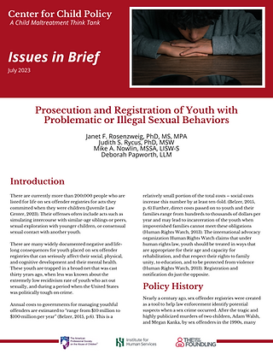
About the Workshop
We will review the research on juveniles who act out sexually from clinical, legal and policy perspectives.
We will introduce the public policy concept of ‘crime control theater’: laws with no demonstratable effect that are too popular with the public to repeal.
We will offer specific calls to action for advocates

Slide 3

QR code to obtain the brief

Slide 4

My Perspective
Health Educator, certified sex educator
Started in 1978, in East Tennessee;
  Sexuality issues were incorporated into all of our staff training, and community presentations to parents, teachers and others.
  Authored a chapter in a text book entitled: Human sexuality issues in the treatment of child sexual abuse (Flanzer, J. The Many Faces of Family Violence. Charles C Thomas Pub Ltd., August 1982)
Helped develop early sex abuse intervention initiatives Tennessee, 1979, Texas, 1982, New Jersey, 1986, Prevent Child Abuse America,
Many years as a public official, including management of a Juvenile Detention Center, and oversite of our Division of Youth Services, working closely with the Family Court judge
2001: Prevent Child Abuse New Jersey, 2011: VP Prevent Child Abuse America; 2015 APSAC Executive Director
Executive Committee of the National Coalition to Prevent Child Sex Abuse and Exploitation www.preventtogether.com
Notes:
Public official - know how hard it is tog et elected officials to spend todays tax dollars to save tomorrows interventions

Slide 5
Points of View
Developmental perspective on individuals and families
Health and sex educator
Sex abuse help-line counselor, therapist and staff trainer
Public official working in child welfare
Prevention specialist – former VP of Prevent Child Abuse America
Mom!

Slide 6
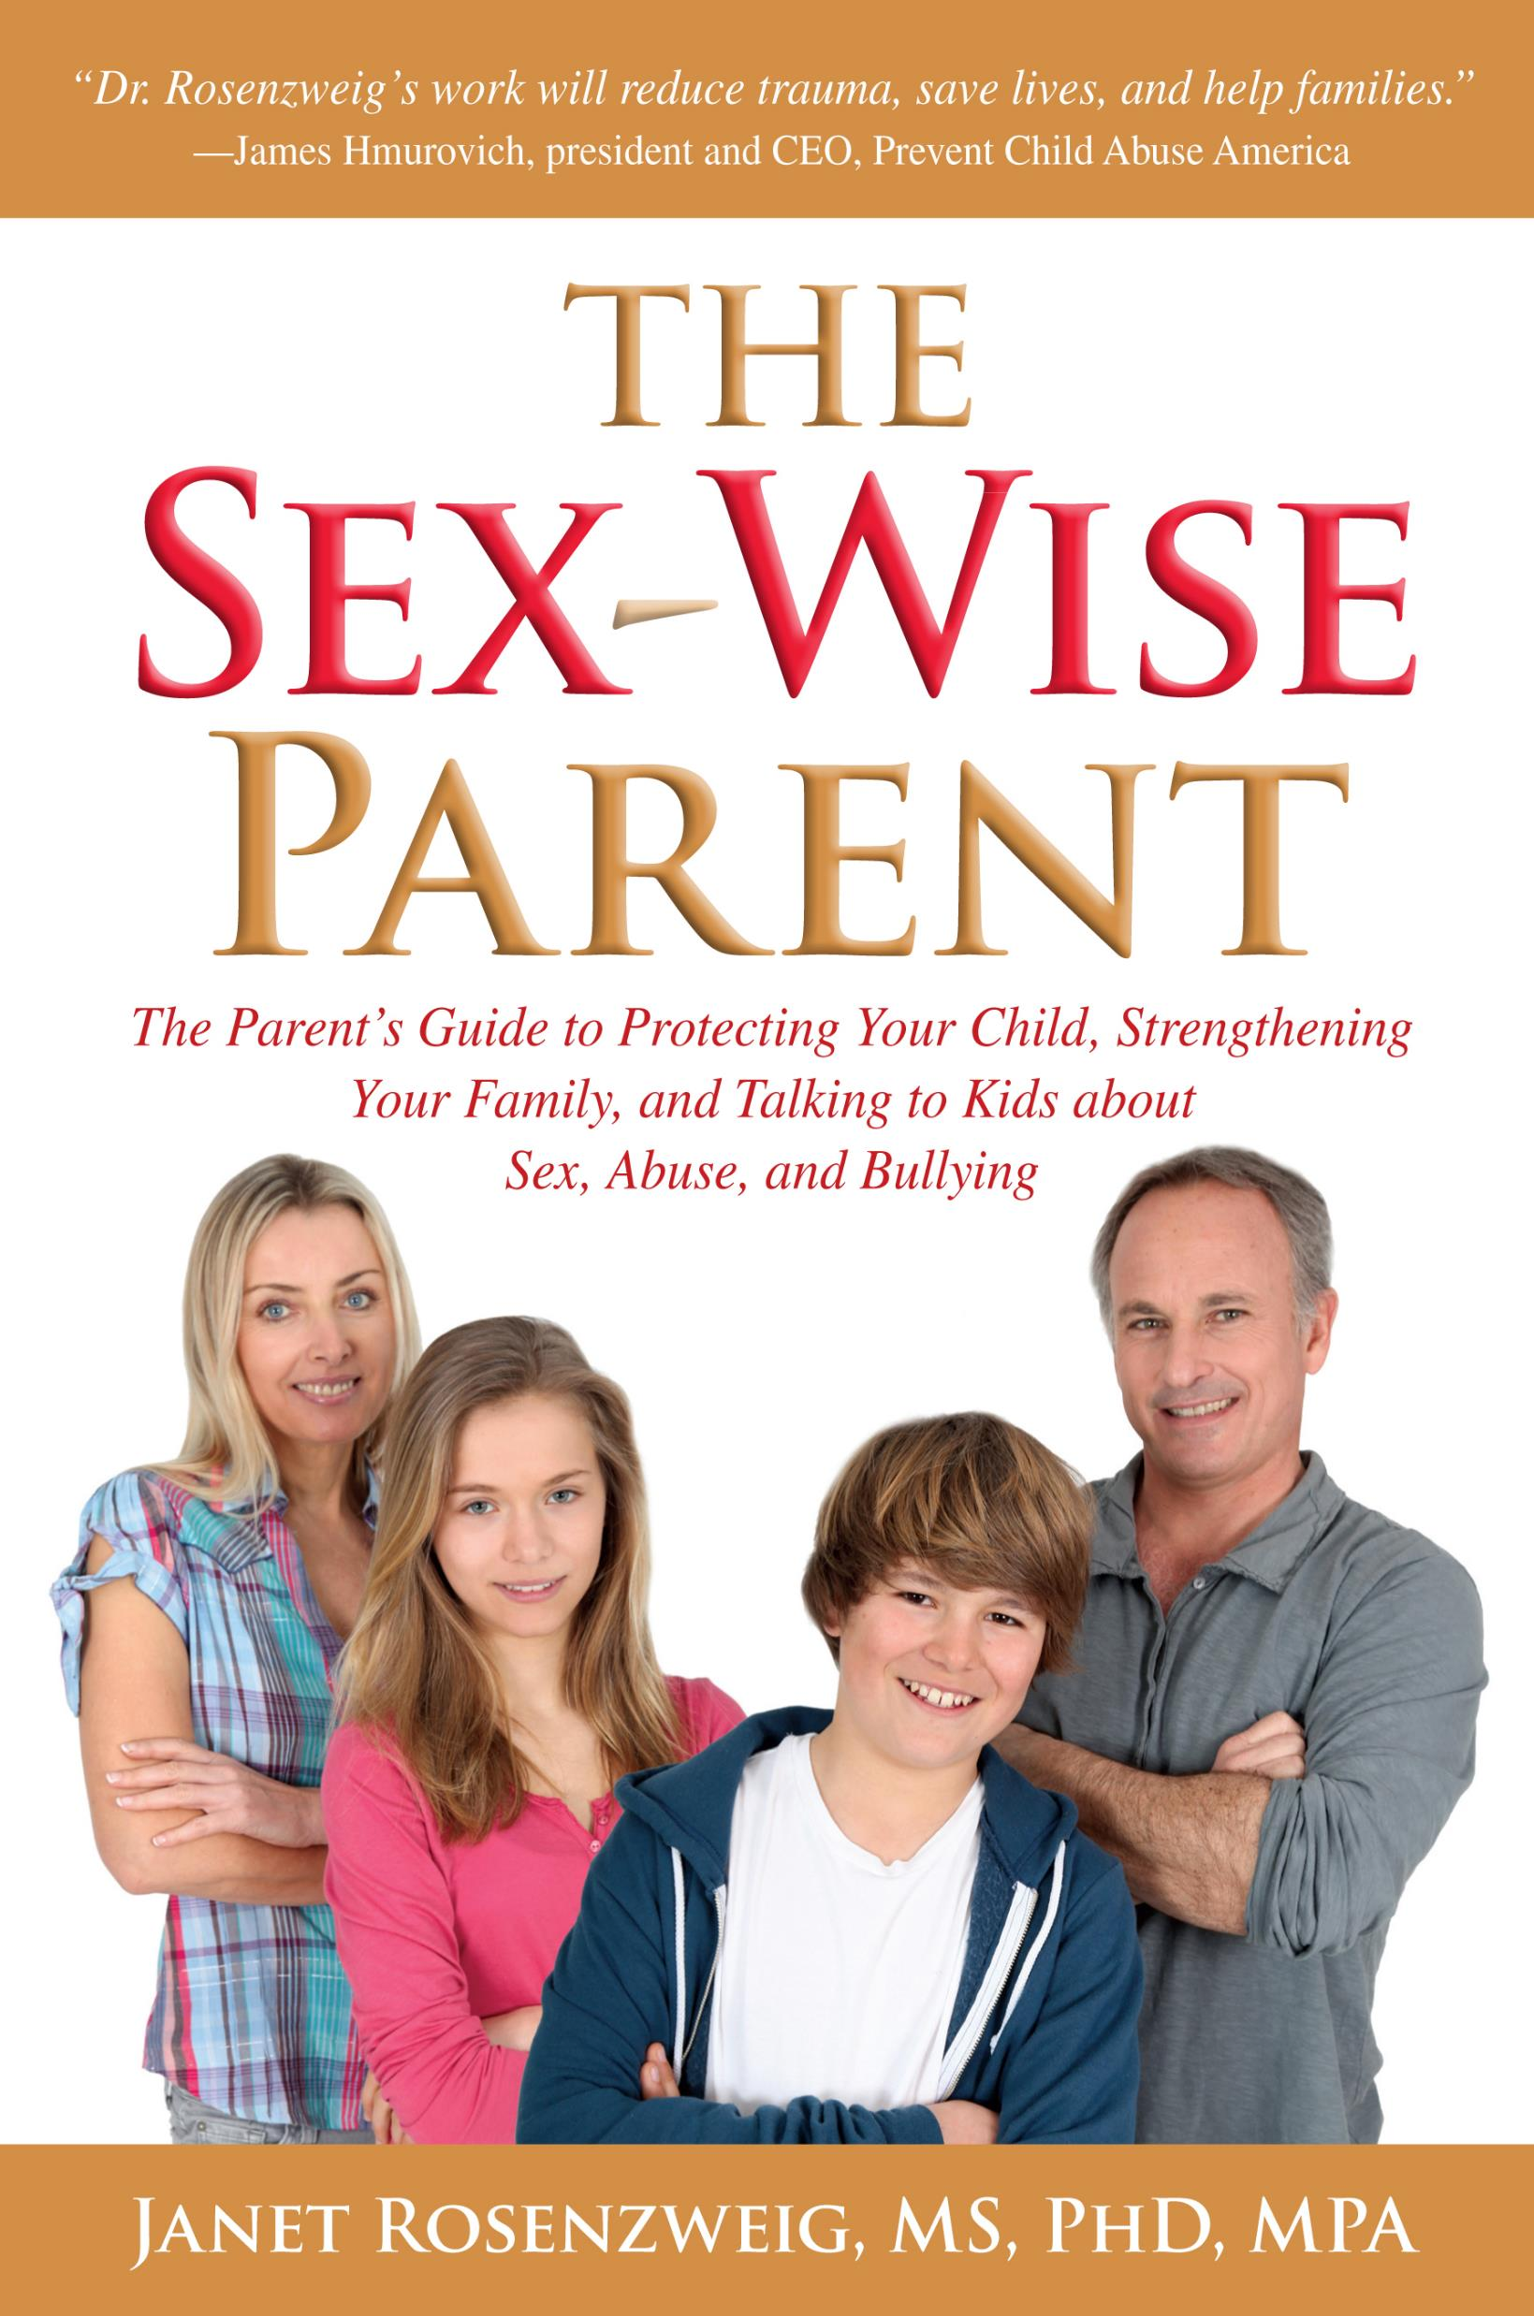


Slide 7
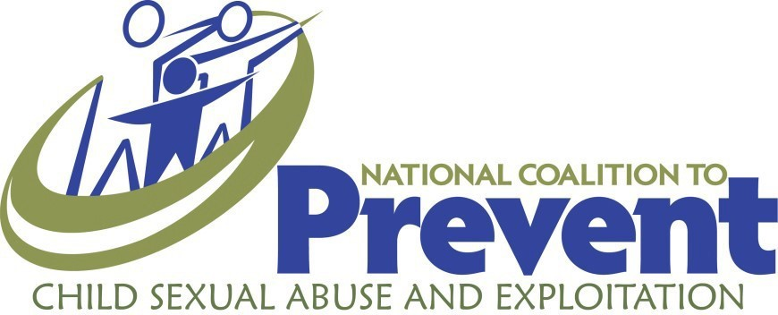
Prevent Together – The National Coalition to Prevent Child Sexual Abuse and Exploitation
Prevent Together is a unified effort to promote the healthy development of children and youth and end child sexual abuse and exploitation. The National Coalition is composed of advocates, educators, researchers, and practitioners working together with a national voice and a critical goal – to end the sexual abuse and exploitation of children.
Notes:
National Center for Missing & Exploited Children (NCMEC) formed advisory group on prevention in 2005. That ultimately became the coalition.
Prevent together, as the coalition is now known, is a collaborative membership organization composed of subject matter experts, researchers, and professionals from organizations in the field of abuse prevention with the mission to encourage, advocate and raise awareness in the United States through evidence-based research to promote prevention strategies to end child sexual abuse and exploitation.
The purpose of this presentation is to promote the National Plan, not to recruit new members into the Coalition.

Slide 8

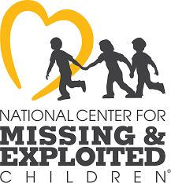


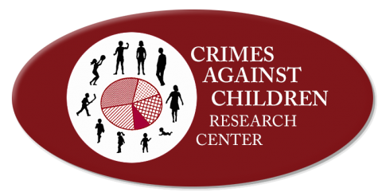
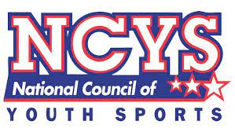




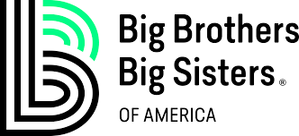

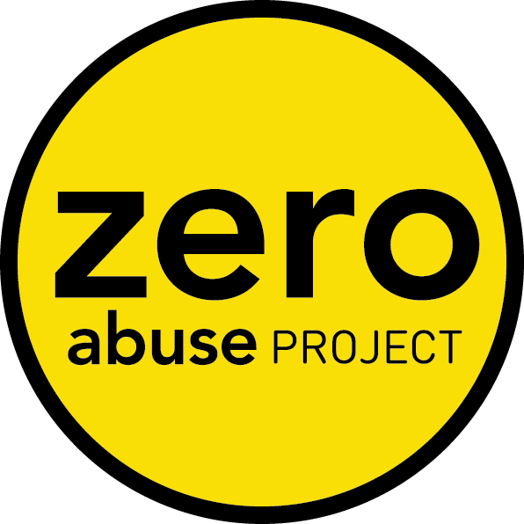
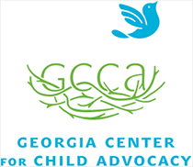
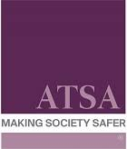



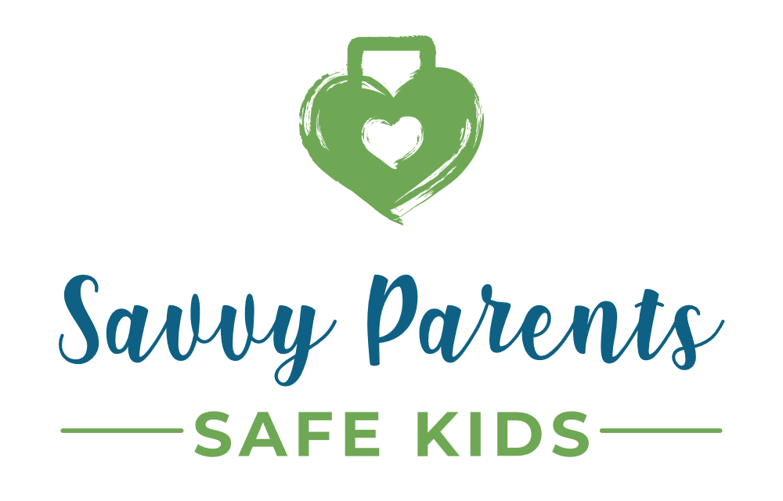
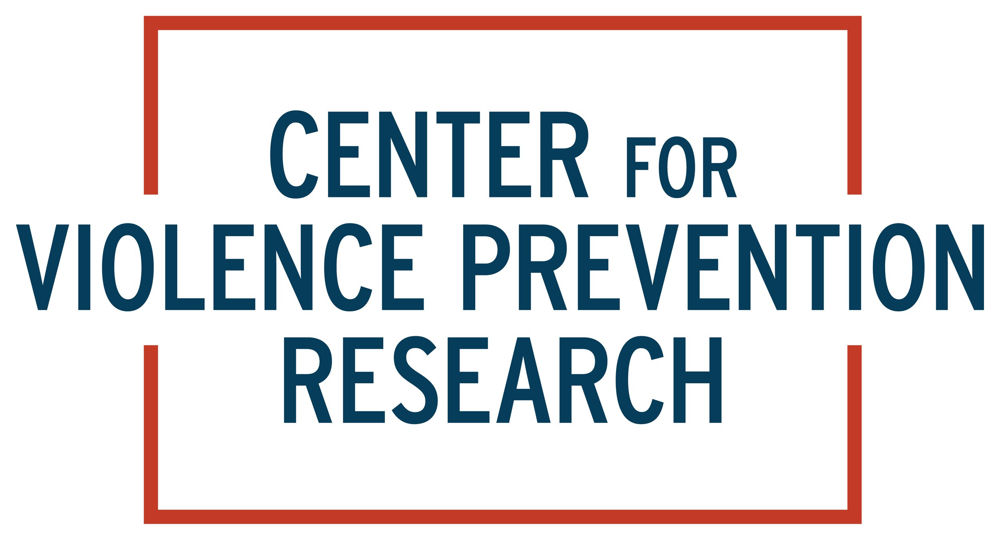
Coalition Members
CDC
Notes:
This is not an all-inclusive list of members; however here are some notable mentions.
Also mention coalition has 16 Individual members such as:
Keith Kaufman
Janet Rosenzweig
Sandra Alexander – subject matter expert from CDC
Joan Tabachnick
Jon Conte
David Finkelhor

Slide 9
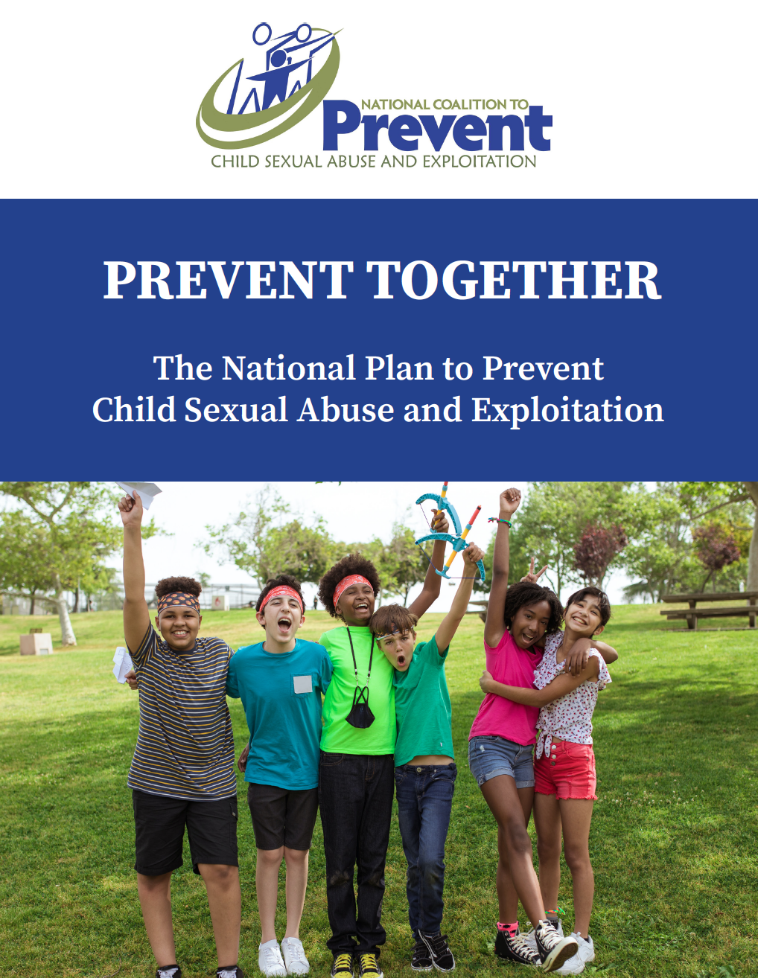

A National Plan to Prevent Child Sexual Abuse and Exploitation
Notes:
Prevent Together has developed a National Plan to Prevent Child Sexual Abuse and Exploitation to provide a framework for effective, comprehensive, and holistic prevention interventions that are culturally sensitive, include survivor and marginalized voices, strengthen child-friendly environments for collective impact, and act as a catalyst for social change for protecting children from sexual abuse and exploitation.
First national plan published in 2008 with six key action areas to promote prevention
Updated in 2012 and again in 2021.

Slide 10
The Benefits of a National Plan
What are the benefits and value of a national plan?
The Plan illustrates that every individual and organization has value and a role to play in contributing to the success of prevention, and it provides and promotes individual, community, and societal-level prevention strategies to accomplish that goal.
Inform and coordinate efforts in the field to better prevent child sexual abuse & exploitation
Don’t have to work in silos
Encourages collaboration
Decreases isolation through connections
What other benefits?
Notes:
The Need for a National Plan:
Many systems and resources focused on child sexual abuse and exploitation are short-term responses initiated after abuse has occurred, for example, victim services, investigation, prosecution, incarceration, mandated reporting, statutes of limitation, and registries. While these are valuable responses, the Plan focuses specifically on primary prevention—actions that take place before child sexual abuse or exploitation occurs. It is tempting to try to identify one major policy or action to act as a catalyst for social change. However, primary prevention requires a broad, more inclusive strategy using knowledge from and action by multiple disciplines. Additionally, a problem as diverse and complex as child sexual abuse and exploitation requires multiple strategies and policies within different environments at a variety of levels.
The Audience of the National Plan:
As a framework and catalyst for action – to get us all moving together in the same direction doing the things that we know will have the greatest impact on preventing CSAE – means this is not something for parents or the public necessarily, it is for the organizations and individuals who are actually doing the work in their communities.
The plan is intended to be collaborative within the field; you may only be one person doing prevention at your organization, but if we are all using the national plan, it can be used to connect with a larger purpose and not feel so isolated.
Could make this an interactive slide by asking the audience what other benefits utilizing a national plan might include.

Slide 11
The National Plan - The Six Pillars
Essential components of comprehensive, effective primary prevention efforts
Critical to develop effective preventative solutions, highlight where progress is needed, and promote factors that can drive change
Notes:
The pillars are the essential components of comprehensive, effective primary prevention efforts, and they are critical to develop effective preventative solutions, highlight where progress is needed, and promote factors that can drive change.
Also note: the Pillars are listed alphabetically, rather than in order of importance, as each Pillar is critical to effective prevention. While it is the totality of the Pillars that will have the most impact on preventing child sexual abuse and exploitation, it is also recognized that not everyone will or needs to be actively engaged with every Pillar. Collectively, with individuals, organizations, and coalitions focusing on these Six Pillars, we will stand the greatest chance of reaching the overall goal together. These are not exhaustive but offer a starting point for those working to implement the Pillars.
So the six pillars are:
Advocacy and Policy
Awareness and Education
Collaborative Practices
Funding and Capacity
Organizational Policies and Procedures
Research

Slide 12
Collectively, with individuals, organizations, and coalitions focusing on the Six Pillars, we will stand the greatest chance of reaching the overall goal together.
PreventTogether@gmail.com
www.PreventTogether.org
Notes:
QR code goes directly to the National Plan on the website. You can also provide your contact information.

Slide 13
Todays workshop
Present research findings on the efficacy of sex offender refisgties
Present Current Knowledge on Youth with Problematic Sexual Behaviors
Clinical, legal and policy perspectives
Calls to Action for Advocates

Slide 14
Note:
All data and research results presented in these slides are fully referenced in the document “Issues in Brief: Removing youth from sex offender registries: promoting justice, safety and fairness” being shared today on paper, link or QR code.
Please do not use or distribute these slides without the accompanying Brief

Slide 15
Outline
Policy History
Current Science
Unintended Consequences
  Recidivism
  Lack of utility of registries in general
Confounding Policy Issues
Crime control theater – challenges in promoting changes
Advocacy
  Early intervention –
  Fair treatment as a juvenile vs being tried as an adult

Slide 16
Introduction
There are currently more than 200,000 people [in the United States] who are listed on sex offender registries for life, for acts they committed when they were children (Juvenile Law Center, 2023). Their offenses often include acts such as simulating intercourse with similar-age siblings or peers, sexual exploration with younger children, or consensual sexual contact with another youth.
“Annual costs to governments for managing youthful offenders are estimated to “range from $10 million to $100 million per year” (Belzer, 2015 p.6). This is a relatively small proportion of the total costs. Social costs increase this number by at least ten-fold. Further, direct costs passed on to youth and their families range from hundreds to thousands of dollars per year and may lead to incarceration of the youth when impoverished families cannot meet these obligations (Human Rights Watch 2013).

Slide 17
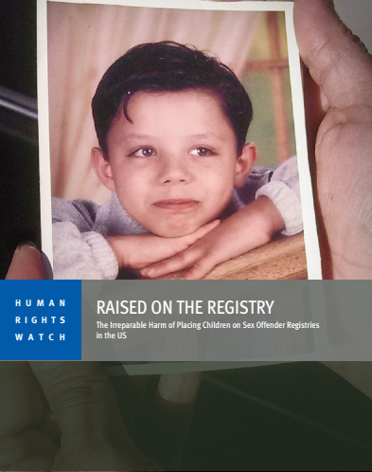
An International Spotlight
The international advocacy organization, Human Rights Watch claims that under human rights law, youth should be treated in ways that are appropriate for their age, their capacity for rehabilitation, and that respect their rights to family unity, to education, and to be protected from violence (Human Rights Watch, 2013).
Registration and notification do just the opposite.

Slide 18
Policy History – How did we get here?
Nearly a century ago, sex offender registries were created as a tool to help law enforcement identify potential suspects when a sex crime occurred
After the tragic and highly publicized murders of two children, Adam Walsh and Megan Kanka, by sex offenders in the 1990s, many states created sexual offender registries and made community notification and publication of information from these registries the norm.
In July 2006, President Bush signed the Adam Walsh Child Protection and Safety Act into federal law, mandating that all states create and maintain sexual offender registries.
The federal Adam Walsh Act has seven major components, referred to as Titles. Title I of the Adam Walsh Act, the Sex Offender Registration and Notification Act (SORNA), listed a comprehensive set of minimum standards to regulate sex offender registration and notification. These were to be implemented in each state by July 27, 2009. A state’s failure to substantially comply with the law could result in a 10% reduction in funding to that state under the Byrne Justice Assistance Grant.
A key provision of the Adam Walsh Act required, by 2011, the inclusion of youth in registration and community community notification activities. Youth who committed an offense after their 14th birthday, and who were adjudicated delinquent for a crime comparable to or more severe than aggravated sexual abuse as defined in federal law (Sexual Abuse Act of 1986) were to be included on the registry (Caldwell et al., 2008).

Slide 19
SORNA
The federal Adam Walsh Act has seven major Titles. Title I of the Adam Walsh Act, the Sex Offender Registration and Notification Act (SORNA), listed a comprehensive set of minimum standards to regulate sex offender registration and notification. These were to be implemented in each state by July 27, 2009. A state’s failure to substantially comply with the law could result in a 10% reduction in funding to that state under the Byrne Justice Assistance Grant.
A key provision of the Adam Walsh Act required, by 2011, the inclusion of youth in registration and community notification activities. Youth who committed an offense after their 14th birthday, and who were adjudicated delinquent for a crime comparable to or more severe than aggravated sexual abuse as defined in federal law (Sexual Abuse Act of 1986) were to be included on the registry (Caldwell et al., 2008).

Slide 20

Strategic Environment 1990’s:
The Myth of the ‘Superpredator’
This federal mandate coincided with an increase in youth crime at the same time that some of the key provisions of the juvenile justice system, developed in the 1950’s and 1960’s, were being rescinded. Together, this set the stage for youth with problematic sexual behaviors to be swept up in the same net as violent sex offenders
The ‘super predator’ myth: The term was coined in 1995 after a criminologist extrapolated from a study in Philadelphia that showed that 6% of the kids known to the juvenile justice system accounted for more than half of the serious crimes.
Just from looking at data, without interviewing one child or their families he ….
‘He blamed these chronic offenders on “moral poverty … the poverty of being without loving, capable, responsible adults who teach you right from wrong.”
DiIulio warned that by the year 2000 an additional 30,000 young “murderers, rapists, and muggers” would be roaming America’s streets, sowing mayhem. “They place zero value on the lives of their victims, whom they reflexively dehumanize as just so much worthless ‘white trash,’" he wrote. ‘
Analysis: How the media created a 'superpredator' myth that harmed a generation of Black youth (nbcnews.com) Read this NBC news analysis!
https://www.nbcnews.com/news/us-news/analysis-how-media-created-superpredator-myth-harmed-generation-black-youth-n1248101

Slide 21
Strategic Environment: The neutered 90’s
Megan's Laws NJ, 1994 (first) federal 1996
  Sex abuse prevention became checking registries
  Adults were concerned about being falsely accused by a child or parent
Abstinence only education funding 1996
  Limited topics to be presented in classes
Jocelyn Elders 1994
Dr. Joycelyn Elders, the highly qualified US Surgeon General was forced to resign after replying to a specific question at a World Aids Day conference asking if she "thought that masturbation could serve as a useful tool to help discourage school children from becoming sexually active too early" by saying: "With regard to masturbation, I think that is something that is part of human sexuality and a part of something that perhaps should be taught".

Slide 22
Jocelyn Elders
1994 Dr. Joycelyn Elders, U.S. Surgeon General, was forced to resign after replying to a specific question at a World AIDS Day conference.
When asked if she “thought that masturbation could serve as a useful tool to help discourage school children from becoming sexually active too early” she stated, “With regard to masturbation, I think that is something that is part of human sexuality and a part of something that perhaps should be taught.”
Foes of Elders’ superior, President Bill Clinton, repeated this one sentence out of context, seeking to paint a dedicated public health official as a pervert who wanted curricula on how to masturbate taught in grade schools.

Slide 23
Restricted Sex Ed
Abstinence only education:
limited finding 1982
massive infusion, 1996
Funded both schools and youth serving agencies
Specified topics that could be covered
Youth had less and less access to accurate information about sexuality – could have been related to an increase in sexually acting out?
What happened when adults spoke franly about sex to youth in the ’90’s?

Slide 24

Judy Blume…

Slide 25
Judy Blume, children's author
“When I began to write, thirty years ago, I didn't know if anyone would publish my books, but I wasn't afraid to write them. I was lucky. I found an editor and publisher who were willing to take a chance. They encouraged me. I was never told what I couldn't write. I felt only that I had to write the most honest books I could.

Slide 26
Judy Blume…..
There were few challenges to my books then, although I remember the night a woman phoned, asking if I had written Are You There God? It's Me, Margaret. When I replied that I had, she called me a Communist and slammed down the phone. I never did figure out if she equated Communism with menstruation or religion, the two major concerns in 12 year old Margaret's life.
But in 1980, the censors crawled out of the woodwork, seemingly overnight, organized and determined. Not only would they decide what their children could read, but what all children could read. Challenges to books quadrupled within months, and we'll never know how many teachers, school librarians and principals quietly removed books to avoid trouble.
Read Judy Blume on censorship

Slide 27
One Result??
Adults, even well-intentioned ones
STOPPED TALKING TO KIDS ABOUT SEX!
Talk about sexuality issues was highly restricted!

Slide 28
The policy to Place Juveniles on registries was developed when
The myth of the super predator was alive and well
Anything that had to do with sex was stigmatized

Slide 29
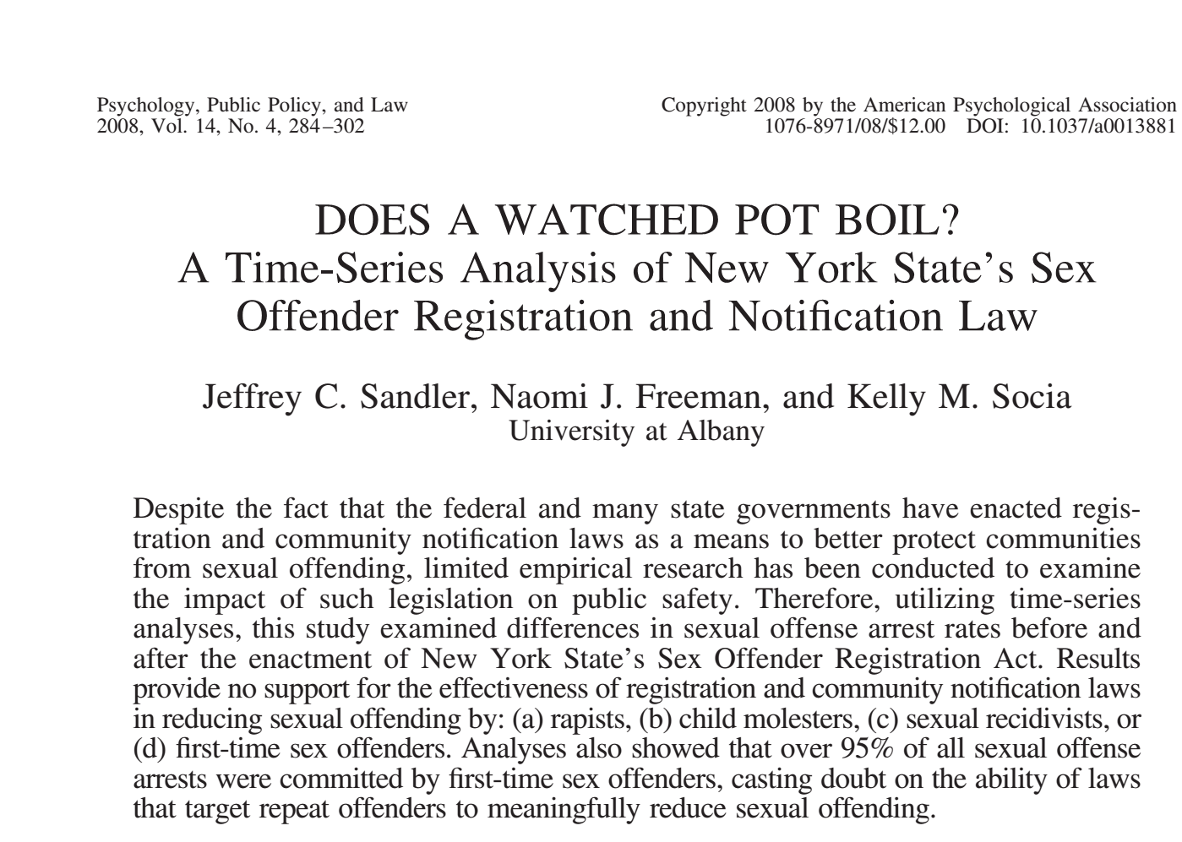
Sex offender registries:
A policy with no effect on rates of abuse
“Results provide no support for the effectiveness of registration and community notification laws…”
Notes:
recap

Slide 30
The bottom line: No impact on rates
“results of the analyses indicate that the 1996 enactment of SORA (and thus the beginning of the registry) had no significant impact on rates of total sexual offending, rape, or child molestation, whether viewed as a whole or in terms of offenses committed by first-time sex offenders or those committed by previously convicted sex offenders (i.e., repeat offenders).”
page 297

Slide 31
More research….
“I use three separate data sets and designs to determine whether sex offender registries are effective. First, I use state-level panel data to determine whether sex offender registries and public access to them decrease the rate of rape and other sexual abuse. Second, I use a data set that contains information on the subsequent arrests of sex offenders released from prison in 1994 in 15 states to determine whether registries reduce the recidivism rate of offenders required to register compared with the recidivism of those who are not. Finally, I combine data on locations of crimes in Washington, D.C., with data on locations of registered sex offenders to determine whether knowing the locations of sex offenders in a region helps predict the locations of sexual abuse. The results from all three data sets do not support the hypothesis that sex offender registries are effective tools for increasing public safety.”
Sex Offender Registries: Fear without Function? Amanda Y. Agan The Journal of Law & Economics Vol. 54, No. 1 (February 2011), pp. 207-239

Slide 32
Freakonomics Agrees
Listen to this podcast:
http://freakonomics.com/podcast/making-sex-offenders-pay-and-pay-and-pay-and-pay-a-new-freakonomics-radio-podcast/

Slide 33
This issue is even more egregious for youth

Slide 34
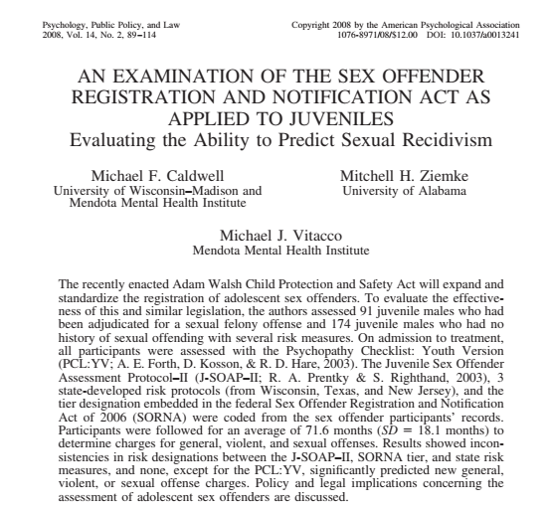
Research: What about states that use a
Risk Prediction Tool?
“Results showed inconsistencies in risk designations between the J-SOAP–II, SORNA tier, and state risk
measures, and none, except for the PCL:YV, significantly predicted new general,
violent, or sexual offense charges. (Psychopathology checklist: Youth Version)
Note that juveniles who did reoffend in this study have ‘extremely high PCL:YV scores.’ with all pathology not necessarily related to sexuality.
This finding ‘cutes across sex offenders and non-sex-offending delinquents alike” ([page 106)
Please read this article for a detailed discussion on how little validity there is among assessment measures!

Slide 35

Unintended Consequences of Registration for Youth
Harassment and unfair treatment
Segregation form nuclear family
Educational Disruption
Financial burdens on their family
Increased risk of suicide
Increased risk of being approached by an adult for sex
  Particularly when they need to report to a public building, with others on the registry for annual check ins

Slide 36
The risk to youth may be increasing
2009 SOMAPI report
  Youth account for 35.6% of reported offenses against youth
    Juveniles Who Commit Sex Offenses Against Minors (ojp.gov) https://www.ojp.gov/pdffiles1/ojjdp/227763.pdf
    More current reports show that number increasing, particularly technology facilitated offenses
    Consider this in the context of adolescent brain development, and other factors in the latest Issues Brief from The Institute for Human Services, Center for Child Policy

Slide 37
Treatment Works and Recidivism is Low

Slide 38
Recidivism is Low
The rate of recidivism is lower for problematic sexual behaviors than for many other types of juvenile offenses (see, for example, Borduin et al., 2009).
Sex offender treatment appears to be more successful with adolescents than it is with adult offenders (Kim et al., 2015).
Community-based treatments have a larger effect in reducing recidivism when compared to institutionally based treatments. The findings reported in Bourdin et al.(2009) highly support this conclusion.

Slide 39
Evidence Based Treatment
There is widespread agreement among researchers that the weight of evidence to date from both individual studies and synthesis research suggests that therapeutic interventions for youth who sexually offend can and do work (Pryzbylsky, 2015).
Community based treatment is even more important when we consider a finding from a meta-analysis reviewing treatment interventions for children with sexual behavior problems, because the primary agent of change for youth sexual behavioral problems appears to be the youth’s parent or caregiver who is engaged in the treatment process (Armand et al., 2008). But in practice, certain provisions of registration and notification laws make it impractical, if not impossible, for youth to access community-based treatment, creating yet another unintended negative consequence of registration.

Slide 40
Cost of Registries
Annual costs to governments for managing youthful
offenders are estimated to “range from $10 million to $100 million per year” ( Belzer)
Add Indirect costs
Costs to victims – costs to families – costs to communities

Slide 41
Costs of Treatment
Cost Effectiveness asks “what does it cost to achieve my effect”
Dopp, et. al, in 2017 dollars
Evaluated 4 sites using the CBT variant designed for youth with PSB’s
  Looked at 6 sites: in 5 of th 6 sites the average cost was below $4,000 per youth (one site was an outlier ay $37,612.. See the article for details
  Included costs of staff training in the evidence based model

Slide 42
Cost Benefit asks: was it worth it?
Treatment is certainly cheaper than registries
The estimated cost for dealing with one case of child sexual abused is estimate to be
Lowest end $210,012 in 2010 dollars

Slide 43
Cost of Registries
Annual costs to governments for managing youthful
offenders are estimated to “range from $10 million to $100 million per year”
Add direct costs
Indirect costs

Slide 44
Aggregated annual costs to governments for managing juveniles ranges from 10 million to 100 million per year ( Belzer)
There are addition costs to families, schools, commuities

Slide 45
Confounding Policy Issues
Registries as ‘Crime Control Theater’
Crime control theater refers to the issue of public policies or programs which have been found to have no effect but are too popular with the public to terminate

Slide 46
Confounding Policy Issues
Registries as Crime Control Theater
Crime control theater refers to the issue of public policies or programs which have been found to have no effect but are too popular with the public to terminate

Slide 47
Confounding Policy Issues
Wide Variations Among States
In the laws, policies or procedures
In judicial approaches
In assessing risk
In updating laws to reflect court cases

Slide 48
Confounding Policy Issues
Challenges in promoting legal changes:
No one wants to be portrayed as either soft of sex offenders or not a protector of children

Slide 49
Confounding Policy Issues
Wide Variations Among States
Sex Offender Registries as ‘Crime
Control Theater’
Challenges in Promoting Legal Changes
Current Issues for Study and Advocacy
Realistic Reframing of Sexual Abuse
Prevention as a Public Health Issue
Safe, Effective Early Intervention
Trying Youth with Problematic Sexual
Behaviors as Adults

Slide 50
Current Issues for Study and Advocacy
Reframing youth with problematic sexual behaviors as a public health problem

Slide 51

Listen! This American Life: Help Wanted
A young man recognizing his attraction to children, wants help
https://www.thisamericanlife.org/radio-archives/episode/522/tarred-and-feathered?act=2

Slide 52
Current Issues for Study and Advocacy
Promoting evidenced based treatment

Slide 53
Current Issues for Study and Advocacy
Trying youth as adults

Slide 54
Current Issues for Study and Advocacy
Have the number of cases changed in the states who have changed their policies about registration and notification for youth?
Preliminary data says it has not.

Slide 55
Take Aways:
Potential applications to your work
Sex Offender registries are NOT effective prevention tools!
Expanding them may make little sense, and in fact do more harm by casting a wide net that catches people who pose no danger.
  This is especially true for youth; note the work of Elizabeth Letourneau
    See her lecture to APSAC here: https://www.apsac.org/videos
Advocacy point: The cost of $1.5 Billion could have been used to support evidence-based interventions, which registries clearly are not.

Slide 56
Calls to Action to Promote Justice and Equity
Learn about policies in your own state affecting youth with problematic sexual behaviors
Replace the term juvenile sex offender’ with ‘youth with problematic sexual behaviors and advocate for peers and colleagues to do likewise
Access the research findings on youth with problematic sexual behaviors and use it to educate others about the lack of effectiveness of registration and notification, and the ensuing serious harms for youth.

Slide 57


Calls to Action to Promote Justice and Equity
.
Use and share the resources offered by The National Center on the Sexual Behavior of Youth (NCSBY)
Work within your communities to move the investment of public funds from registries and enforcement to supporting professionals to deliver evidence-based interventions.
  Implementing the Adam Walsh Act of 2006 was conservatively estimated to cost $300,000,000 per year in direct costs (Sandler at al. 2008), and social costs can increase that by 10-fold with little social benefit (Belzer 2015).Evidence-based community treatment is estimated to cost less than $5,000 per child (Dopp, et al., 2020), and primary prevention even less.
www.ncsby.org

Slide 58
QR code to obtain the brief
THANK YOU!
Dr. Janet Rosenzweig
Senior Policy Analyst
The Institute for Human Services
Columbus OH
Jrosenzweig@ihs-trainet.com

