Slide 1
Supporting Medical Professionals to Talk to Parents About Healthy Sexual Development
Parental Support and Values + Medically Accurate Sex Information = Sexual Health and Safety

Slide 2


Brought to you by:

Slide 3






Introducing the New York State Initiative to Prevent Child Sexual Abuse
Brought to you by:
The New York State Initiative to
Prevent Child Sexual Abuse
The Initiative is dedicated to the prevention of all forms of child sexual abuse throughout the state of New York through advancing research, policy, education and practice. We are organized as a cooperative initiative to provide state-of-the-art theory and research-based knowledge to inform, guide, and empower the public, professionals, and all those who serve children and families at all levels and sectors of society, toward the elimination of child sexual abuse. The Initiative is comprised of leaders in the field of child maltreatment, child protection, and promotion of well-being in children and families.
Learn more about us here: https://www.nypreventsexabuse.org/

Slide 4
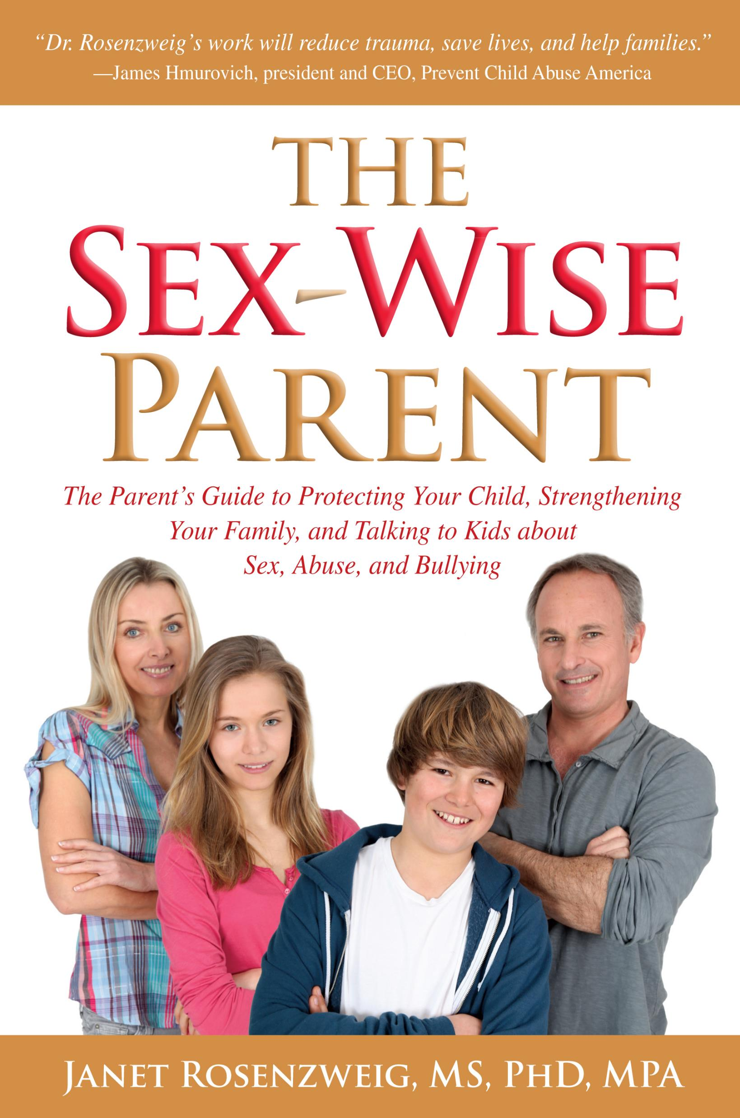
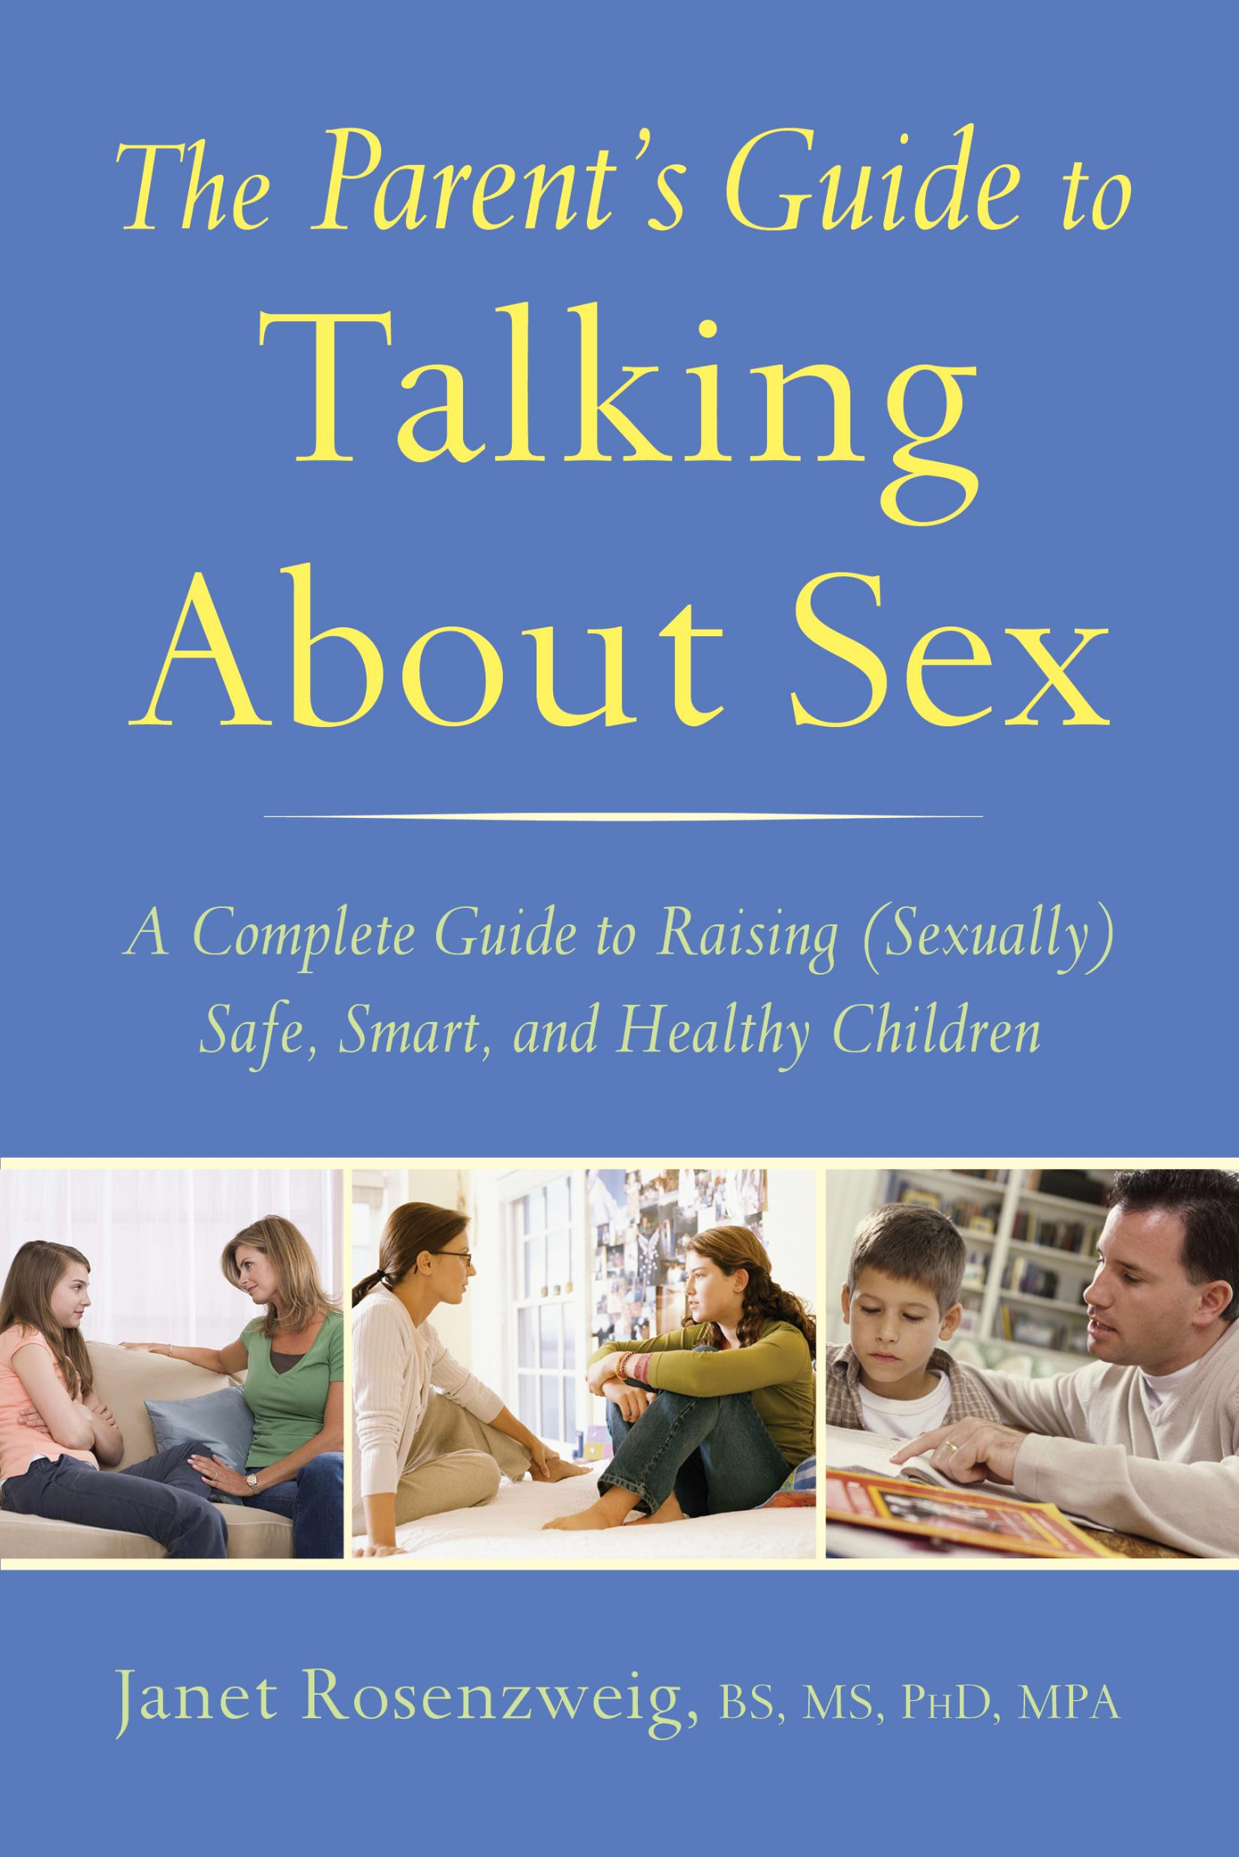
Presented by:
Janet Rosenzweig PhD, MPA

Slide 5
Perspective
Developmental perspective on individuals and families
Health and sex educator
Sex abuse help-line counselor, therapist and staff trainer
Public official working in child welfare
Prevention specialist – former VP of Prevent Child Abuse America
Mom!

Slide 6
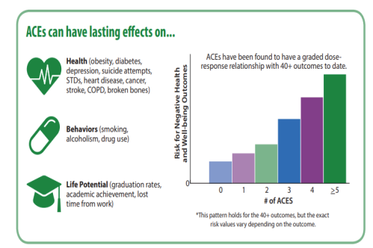
Context: The Adverse Childhood Experiences (ACE) Studies
https://www.cdc.gov/violenceprevention/pdf/preventingACES.pdf

Slide 7
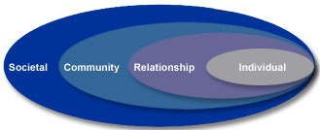
Context: The social ecology of prevention
This presentation will start with the individual and relationship/family levels.
Medical personnel have important roles at all levels.
Learn more from the CDC and P

Slide 8

My Ideal:
Each child should be able to go out in the world with age appropriate, medically accurate information about human sexuality, all wrapped up in the values of their family and faith tradition.

Slide 9
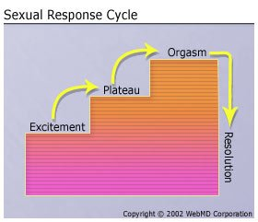
Physical Facts with Emotional Impact
Fact 1:
The human body will react to various kinds of stimulation with very specific physical manifestations

Slide 10
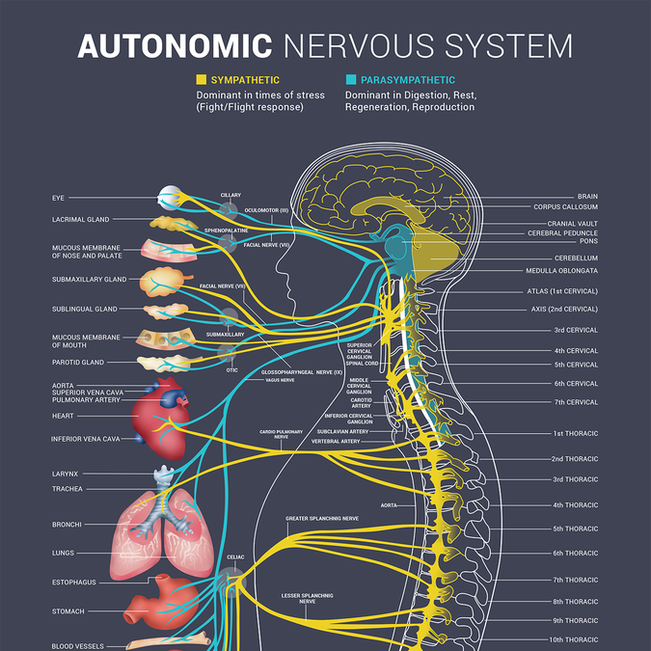
Physical Sexual Arousal
The Autonomic Nervous System:
The part of the nervous system responsible for control of the bodily functions not consciously directed, such as breathing, the heartbeat, and digestive processes.

Slide 11
Key words!
not consciously directed, such as breathing, the heartbeat, and digestive processes.
Physical sexual/genital arousal is an autonomic response

Slide 12

Key reasons why kids need to know this
Victims may experience a physical, sexual/genital response while being victimized
  Predators may use the response against them, convincing the child they a willing participant because they ‘enjoyed’ the act.
Notes:
Add the issue of same gender abuse – concision about sexuality

Slide 13
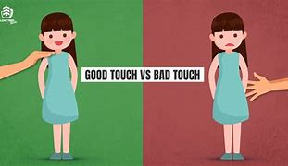

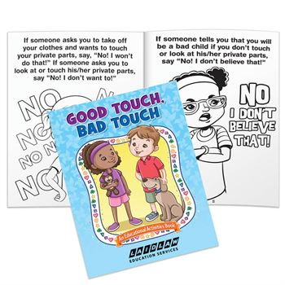
Key reasons why kids need to know this
Victims may experience a physical, sexual/genital response while being victimized
  This is wildly confusing for children who have experienced sexual abuse prevention as only ‘good touch/bad touch’
Notes:
Add the words from an adult victim who thanked me

Slide 14
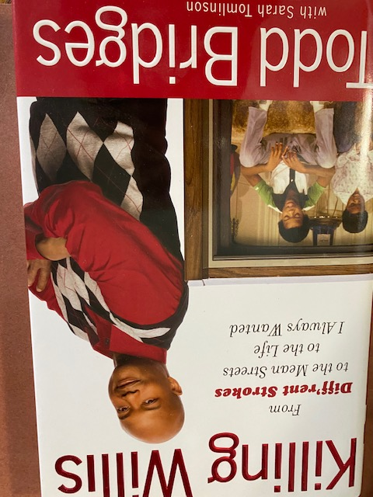
Account from a victim
Child TV star describes being molested by his publicist:
“Pull your pants down,” he said.
I didn’t want to lose everything he had given me. And so I did.
He put his mouth on me. I got hard. I didn’t know where to look or how to feel. I squirmed against the back of the seat. He kept on going, getting into it.
I hoped it would be over fast.
Then it happened. I came.
As confused and upset as I was, I liked the feeling.”
“No one had ever talked to me about sex before, but somehow, I knew it was wrong for a man to do that to a boy. I was really confused because having an orgasm had felt good.”

Slide 15
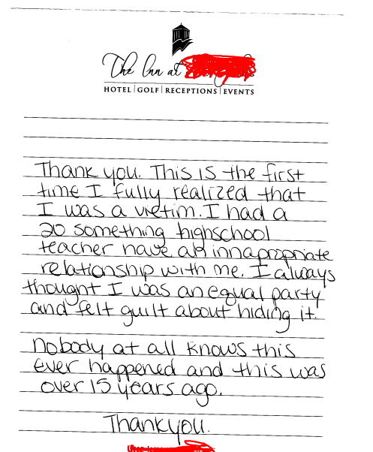
Knowledge is Power!

Slide 16
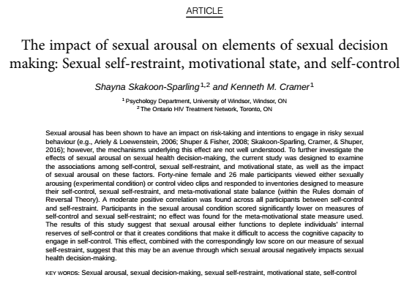
Sexual arousal influences sexual decision behavior and reduces restraint!

Slide 17

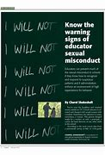
Key reasons why kids need to know this
Kids may confuse a physical sexual/genital response for an emotional attachment, making them vulnerable to predators.
Adolescents and teens are particularly vulnerable
Physical sexual/genital arousal decreases sexual self restraint
Physical sexual/genital arousal may lead a victim to believe they participated in a sinful act, unnecessarily adding to guilt and confusion
Notes:
Add the words from an adult victim who thanked me

Slide 18
Key reason why parents need to understand that arousal is autonomic
To understand why kids like to touch their genitals
To avoid unhealthy messages – we don’t want children to learn to associate negative emotions with their sexual arousals.
  Fear, guilt and shame have no place in healthy sexuality
  At best interferes with healthy adult sexual relationships
  At worse a child can grow into someone who needs these negative emotions to experience sexual arousal

Slide 19
Let’s go back to Psych 101 for a moment:
Operant conditioning is a learning method in which a specific behavior is associated with either a positive or negative consequence. Thus, this form of learning links the taking of certain voluntary actions with receiving either a reward or punishment, often to strengthen or weaken voluntary behaviors.
    Think BF Skinner....
Classical conditioning is a learning process focused more so on involuntary behaviors, using associations with neutral stimuli to evoke a specific involuntary response.
    Think Pavlov…..

Slide 20
Physical Facts with Emotional Impact
Fact 2:
Having accurate, understandable language about all body parts, specifically the genitalia is a protective factor in sexual abuse prevention
  If a child becomes a victim, they have language to tell a trusted adult

Slide 21

Physical Facts with Emotional Impact
Fact 2:
Having accurate, understandable language about all body parts, - particularly the genitalia is a protective factor in sexual abuse prevention
  A child who knows it is OK to talk about sex with their parent will be able to ask questions, and not be tempted to turn to unsavory sources such as the internet, or possibly predatory older kids or adults

Slide 22
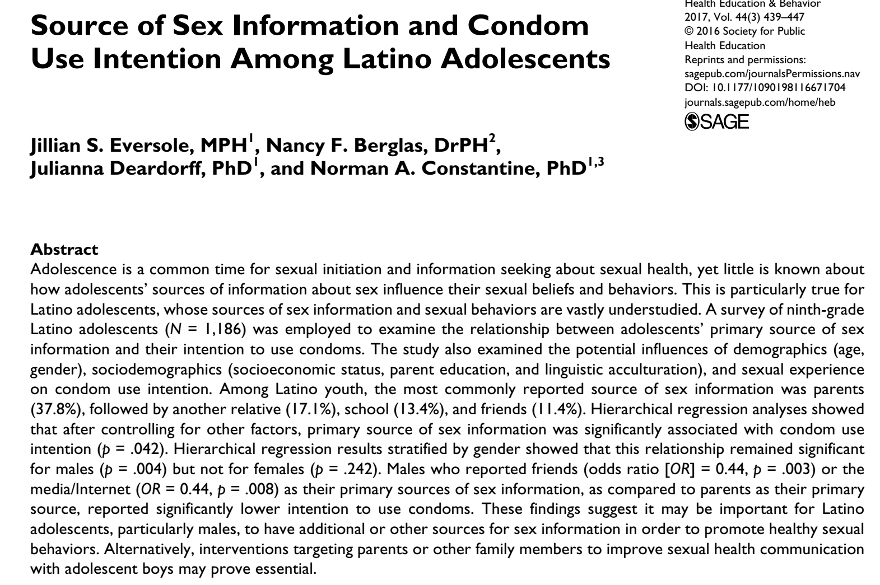
Example: When parents are a source of sex information, condom use increases

Slide 23
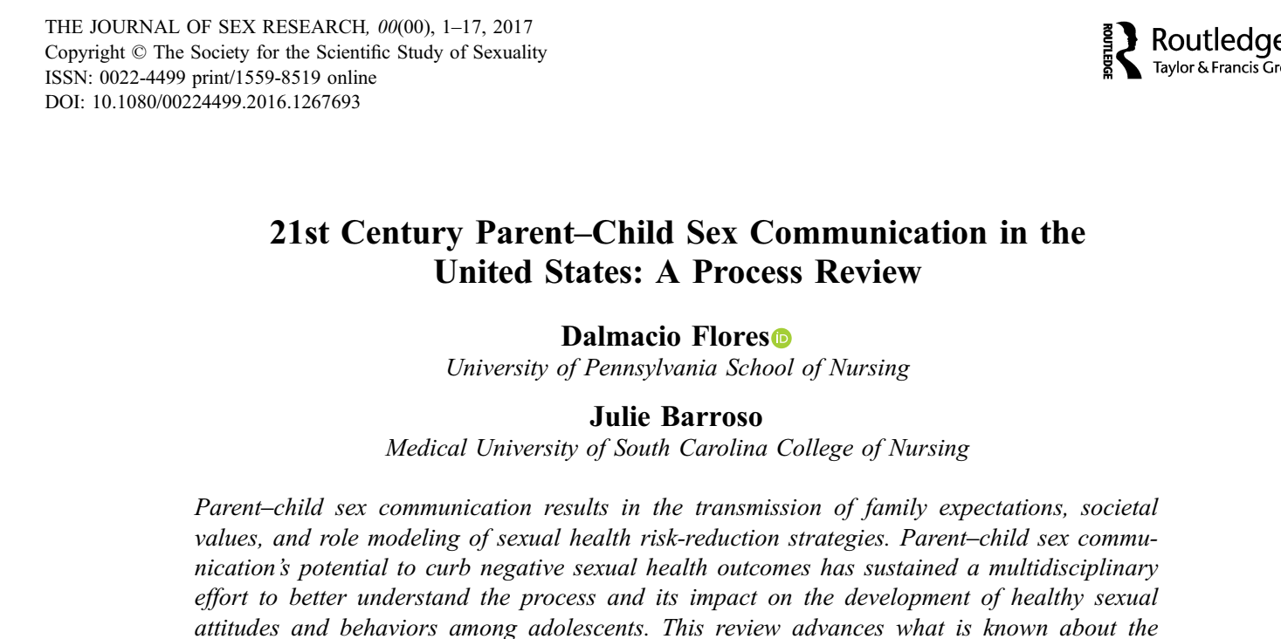
Parents communicate important information and values to their children

Slide 24
Medical personnel are a key source of sexuality information!
They are consistently rated as a highly credible source of sexuality information!

Slide 25
A Little History
Video to be played here

Slide 26
Access to accurate information about human sexuality was strongly curtailed starting in the 1990
Comprehensive sex abuse prevention was replaced with Megan's Laws starting in the mid 1990’s
  Sex abuse prevention became checking registries
  Adults were concerned about being falsely accused by a child or parent if they spoke to a child abuse sex
Abstinence only education funding 1996
  Limited topics to be presented in classes
Jocelyn Elders 1994…..

Slide 27
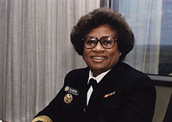
Jocelyn Elders
1994 Dr. Joycelyn Elders, U.S. Surgeon General, was forced to resign after replying to a specific question at a World AIDS Day conference.
When asked if she “thought that masturbation could serve as a useful tool to help discourage school children from becoming sexually active too early” she stated, “With regard to masturbation, I think that is something that is part of human sexuality and a part of something that perhaps should be taught.”
Weeks after the event, foes of Elders’ superior, President Bill Clinton, repeated this one sentence out of context, seeking to paint a dedicated public health official as a pervert who wanted curricula on how to masturbate taught in grade schools.
Notes:
30 years ago– many of you were at the formative stages of your career ---- what message did this leave with you???

Slide 28
Restricted Sex Ed
Abstinence only education:
limited finding 1982
massive infusion, 1996
Funded both schools and youth serving agencies
Specified topics that could be covered

Slide 29


Slide 30
“When I began to write, thirty years ago, I didn't know if anyone would publish my books, but I wasn't afraid to write them. I was lucky. I found an editor and publisher who were willing to take a chance. They encouraged me. I was never told what I couldn't write. I felt only that I had to write the most honest books I could. “
T
“….the censors crawled out of the woodwork, seemingly overnight, organized and determined. Not only would they decide what their children could read, but what all children could read. Challenges to books quadrupled within months, and we'll never know how many teachers, school librarians and principals quietly removed books to avoid trouble. “
Read Judy Blume on censorship
it’s timely …

Slide 31
One Result??
Adults, even well-intentioned ones STOPPED TALKING TO KIDS ABOUT SEX!
Kids are left vulnerable getting inaccurate information and ‘values’ about sexuality from peers, predators, or pornography

Slide 32

The members of the generation educated under these restrictions are now parents!
They need your help….

Slide 33

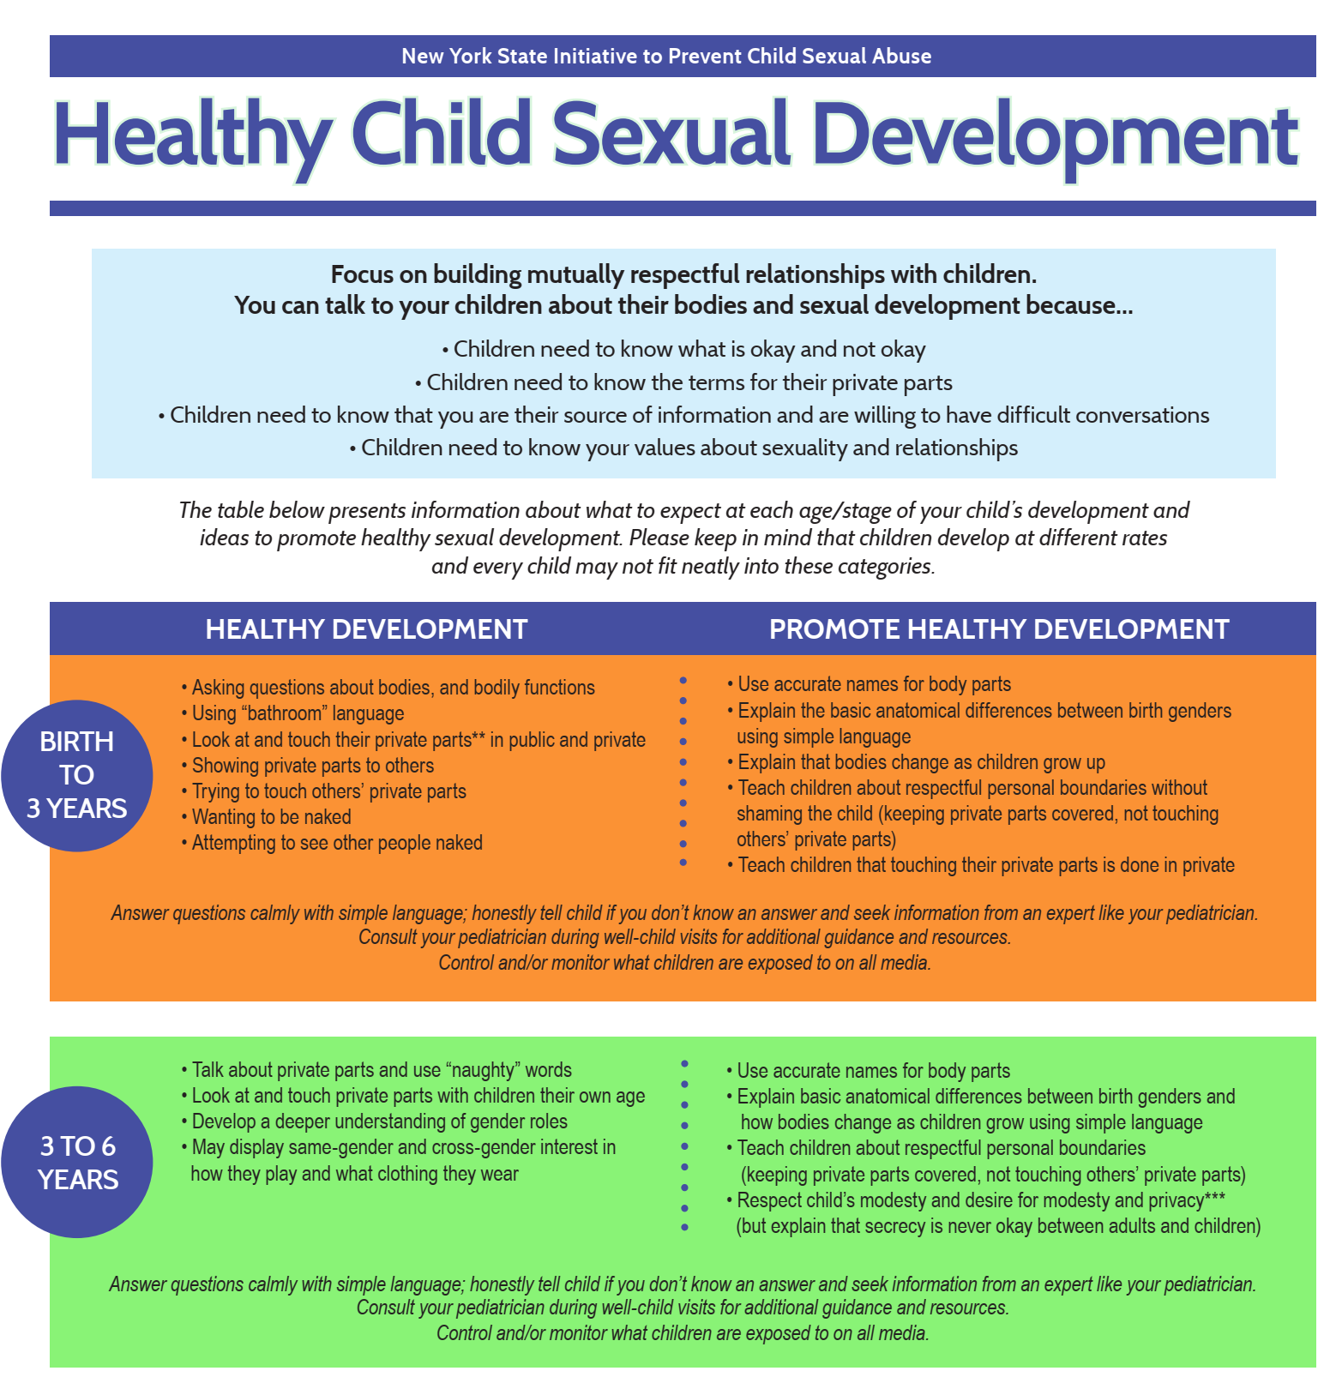
We will provide you with resources to give parents that can be helpful!

Slide 34

Medical Professionals are among the very few adults who have ‘social permission’ to talk to kids about sex!

Slide 35
Anatomy and Physiology for Grownups
The next slides
are anatomical
line drawings
of male and female
sexual and reproductive organs, with simple suggestions for describing to kids

Slide 36
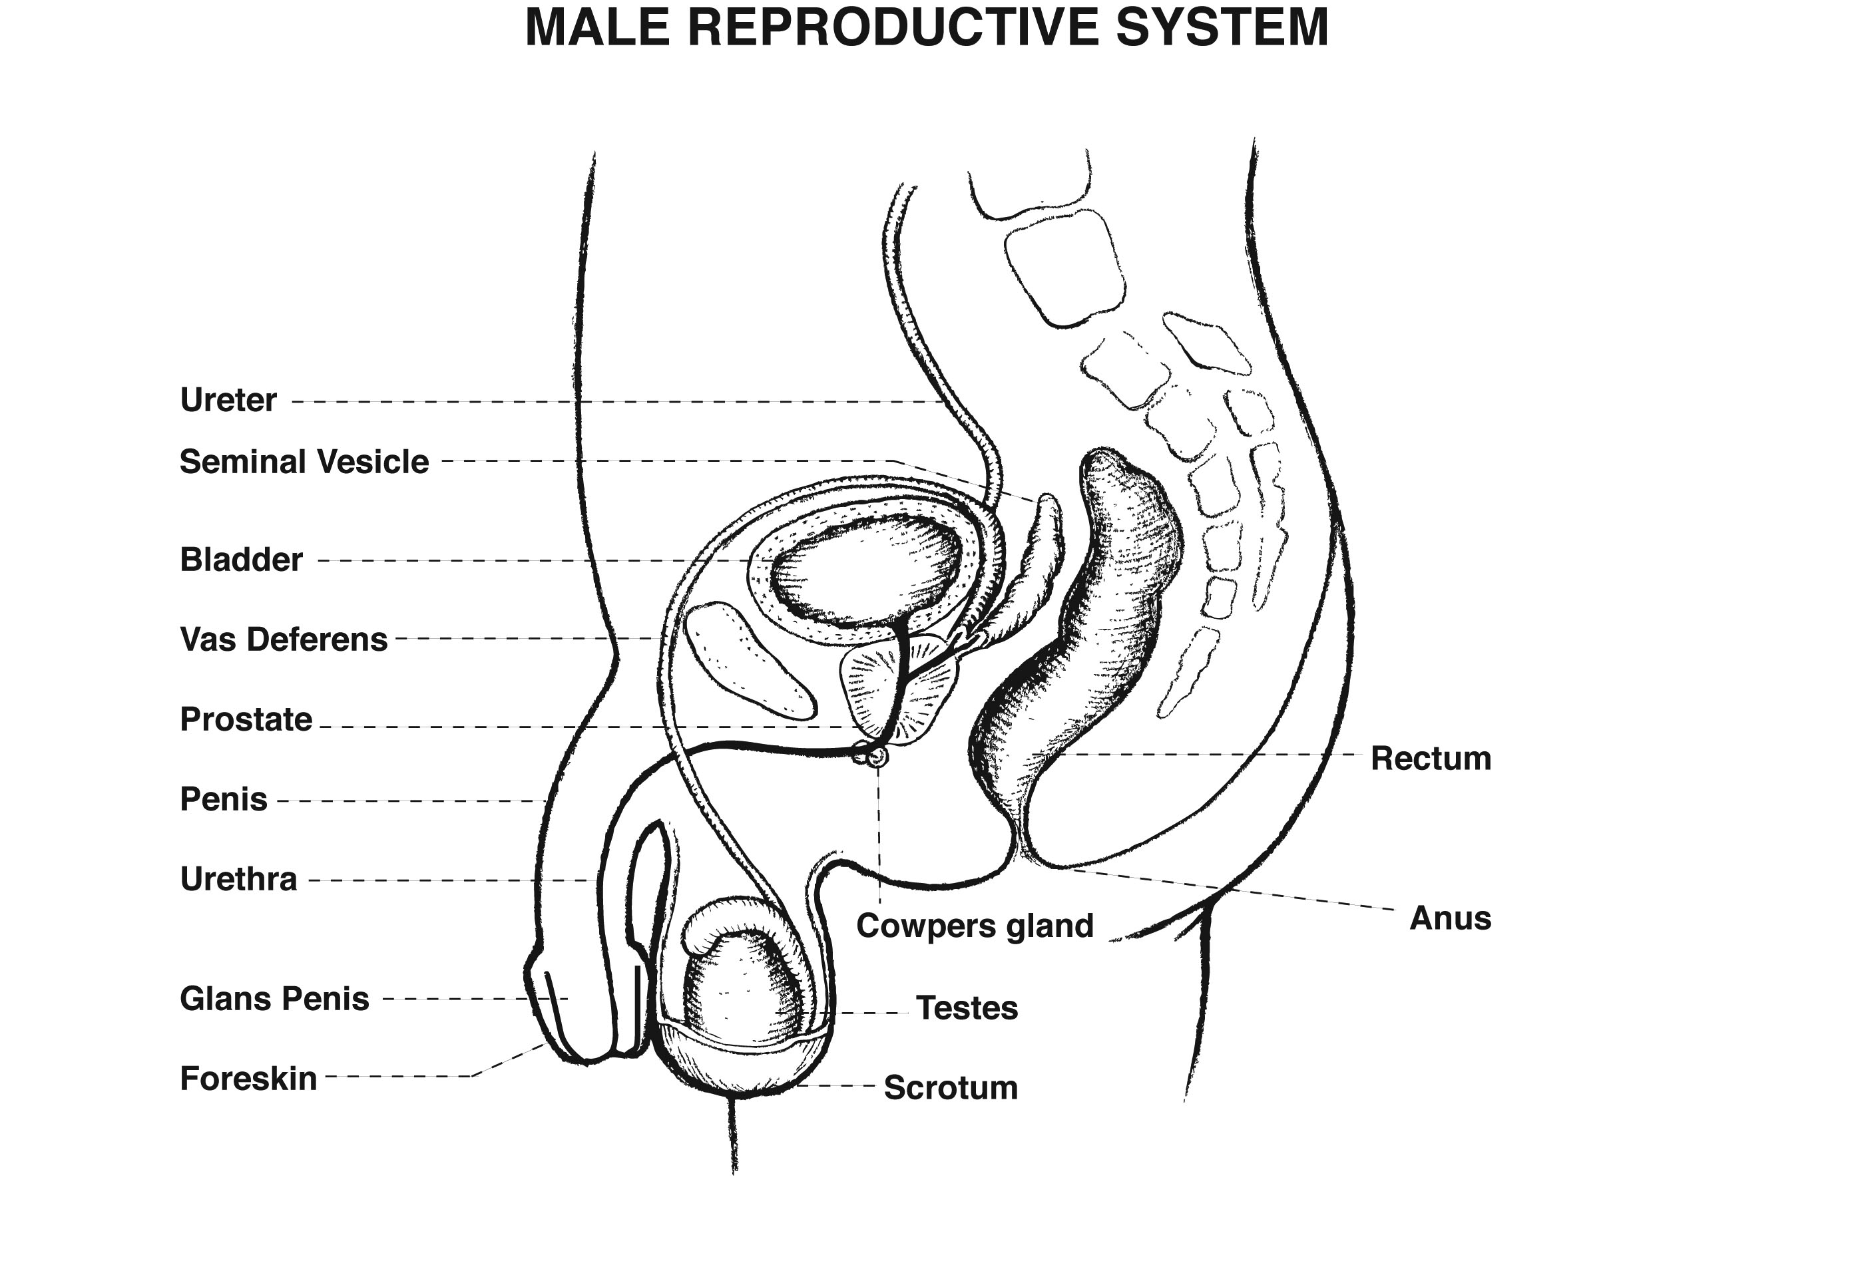

Slide 37
Important concepts for kids – male anatomy physiology
School aged and younger
  Testicles are located inside of scrotum
  Scrotum tighten up when they’re cold
  Penis’ get big when they feel certain things – like getting goose bumps from being tickled, it happens and it means things are working
School aged/young adolescent
  Sperm or Dad’s seeds are produced in the testicles and follow the tube around to come out the tip of his penis
  Note for treatment folks – knowledge of how bodies work can help give back a sense of control
  Sad case of adolescent who had been victimized by her older brother, sharing a bed with her younger brother; she masturbated his nocturnal erection to prevent it from hurting her.

Slide 38
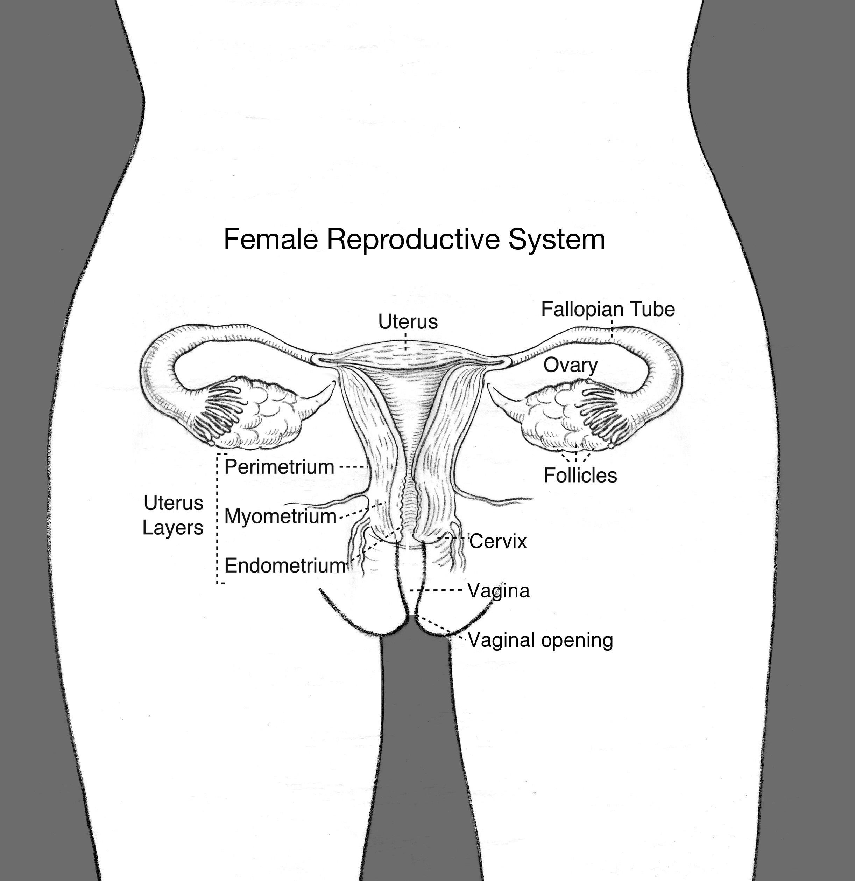
title
Treatment folks should be able to name the major anatomical structures in this diagram and be able to help explain the menstrual cycle to kids. Predictability helps bring back a sense of control for victims.

Slide 39
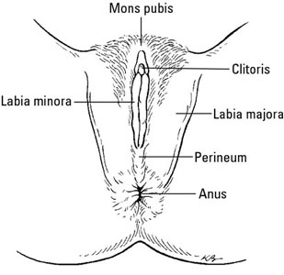
Female External
Between the labia minora is the urethra, which leads to the bladder and is the opening through which urine passes
Between the labia minora is the vagina, which leads to the uterus. This is the opening through which menstrual fluid – and possibly a baby! passes

Slide 40
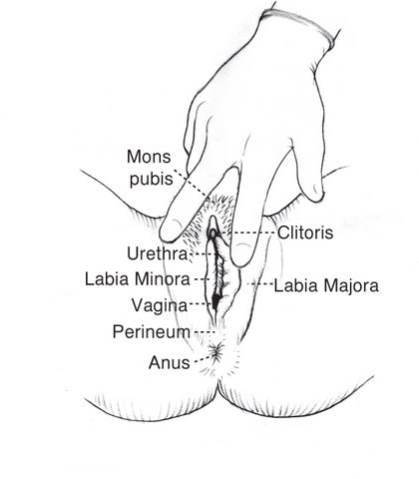
Female External

Slide 41
Important concepts for kids – female anatomy physiology
School aged and younger
  Sometimes it feels good to touch your genitals. That’s fine, but we don’t touch anyone else's, and no one else touches ours.
School aged/young adolescent
  Girls have one opening for urination/peeing attached to the balder and another for periods/ childbirth that is attached to the womb
  Menstrual fluid is only partially made of blood – there is other tissue being expelled, and the blood makes it all read. You're not bleeding, you're healthy!

Slide 42
Parents Fears and how you can help…
If I talk about sex, they’ll be sexually active
  Research sows the opposite is true
Kids don’t want to hear my opinion
  Research shows the opposite is true. Developmentally, kids frame of reference switches from the nuclear family to their peer group in adolescence. Take every opportunity to communicate family values and key information while in grade school, and reinforce it with adolescents.
  They may not appear to pay attention but they are listening!
They might ask me a questions I don’t know the answer to
  Be honest and say you don’t know the answer then find it. Search reliable websites ( .edu ); contact your pediatrician's office
They might ask me about my own sexual behave
  This is a great opportunity to model boundaries and privacy, two things critical to sexual health and safety. “My sexual experiences are private and I’m not OK sharing them with you.. And his is something I hope you can learn to say about sexuality to anyone e-even someone you love”

Slide 43

Sexual Climate
In the Home
Resource: – Family Norms Exercise

Slide 44
Assessing family values – defining NORMS
What do we mean by NORMS?
Adults come to relationships with expectations or norms about every aspect of sexuality and sexual behavior and it would be very rare for two people to have exactly the same norms when entering a relationship. Part of building a strong foundation for a relationship includes working to clarify and articulate these expectations, then agreeing on a compromise when differences are discovered.

Slide 45
Support Parents to consciously set norms!
A message to communicate to parents:
“Traditional and social media and peer pressure will
direct plenty of confusing messages about sex to your children. By clarifying your family's norms and expressing them to your kids, confusion can be replaced with knowledge and comfort. And most importantly of all, your child will know and most likely come to share your values, a dream come true for parents.”

Slide 46
Family Norms about Language
What words will be use for all body parts
  Caution not to refer to the genitals as the ‘dirty parts’
  If you choose to go with ‘private parts’, teach your kids the name for each of the parts
What words we will use for urination and defecation

Slide 47
Family Norms about Dress
Be very clear about who sees whom in underwear (or less); this becomes a particularly important question in two circumstances—
  when a child approaches puberty and
  when new members are entering the household, such as the blending of families.
  It’s not uncommon for both things to happen around the same time.

Slide 48

Norms about privacy
Bathroom and bedroom doors opened or closed?
How will we handle visitors used to different rules? How will we handle visiting homes with different rules?
  Parents know that friends and family willing to host kids for an overnight visit are a GIFT, but make sure everyone knows the norms !

Slide 49
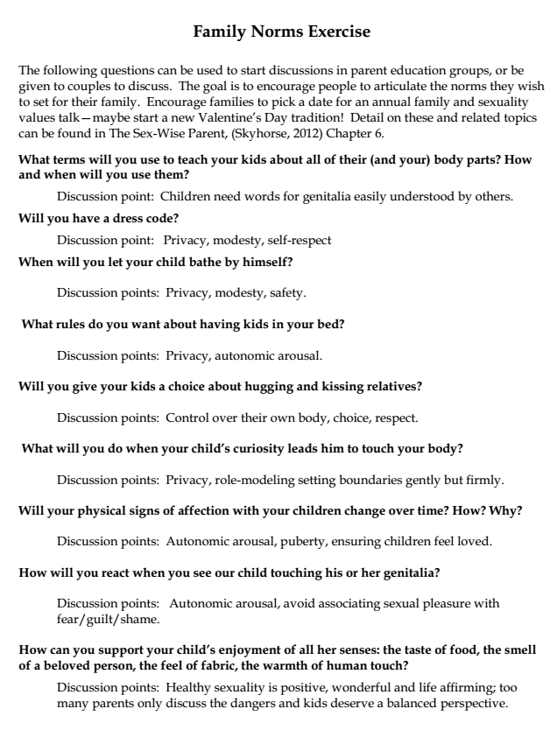
Conversations to consider for anticipatory guidance…
This exercise is provided as a handout for this workshop!
Notes:
This is in your handout

Slide 50
Before we leave families --
A word about siblings

Slide 51

Siblings: The good, the bad and the ugly….
Older siblings are an important source of information about the ‘facts’ of sex and the family values.
  Some parents engage an older child as a partner in sharing information with the younger ones
Older siblings can also be terrifying bullies
  When kids fight (which is normal) determine if the younger/smaller one is mad or terrified.
  One widely cited study found 13% of a college population reported sibling incest.
Finkelhor. “Sex Among Siblings: A survey on prevalence, variety and effects.” Archives of Sexual Behavior (9), 1980: 171–194.

Slide 52
Link to bullying
Sex abuse is bullying taken to a grotesque extreme.
The perpetrator cares only for their own satisfaction with absolutely no regard for the impact their behavior has on others.
Older, more powerful siblings may learn bullying behavior at home
Bullying prevention programs, when done well are an important component to community sexual health and safety. Another role for schools – many of whom are incorporating bullying prevention into curricula!

Slide 53
Moving up the social ecology

Slide 54
Regardless of the specific religious tradition, the concept of ‘spirituality’ provides a perfect backdrop to teach the values of love, empathy, honesty and respect which are all critical components of sexual health and safety
The medical community can step up!
Consider stepping up in your own faith-based institution to lead workshops for parents.
Advocate for resources in faith based, health and community organizations to support parents to become the primary sex educators of their children

Slide 55


Steps to take in your community
Encourage schools to adopt the National Sexuality Education Standards, endorsed by The American School Health Association, The American Association for Health Education, The Society of State Leaders for Health and Physical Education, and the National Education Association Health Information Network

Slide 56
Resources!

Slide 57
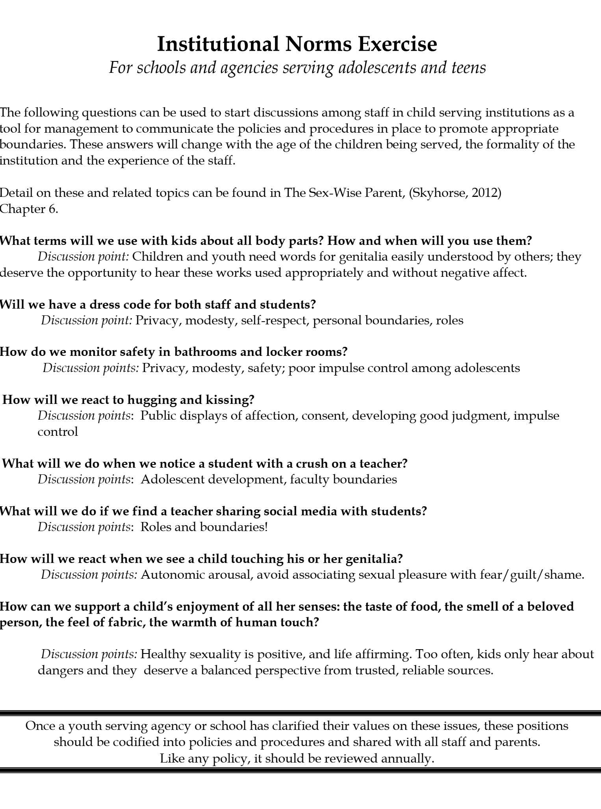

Slide 58
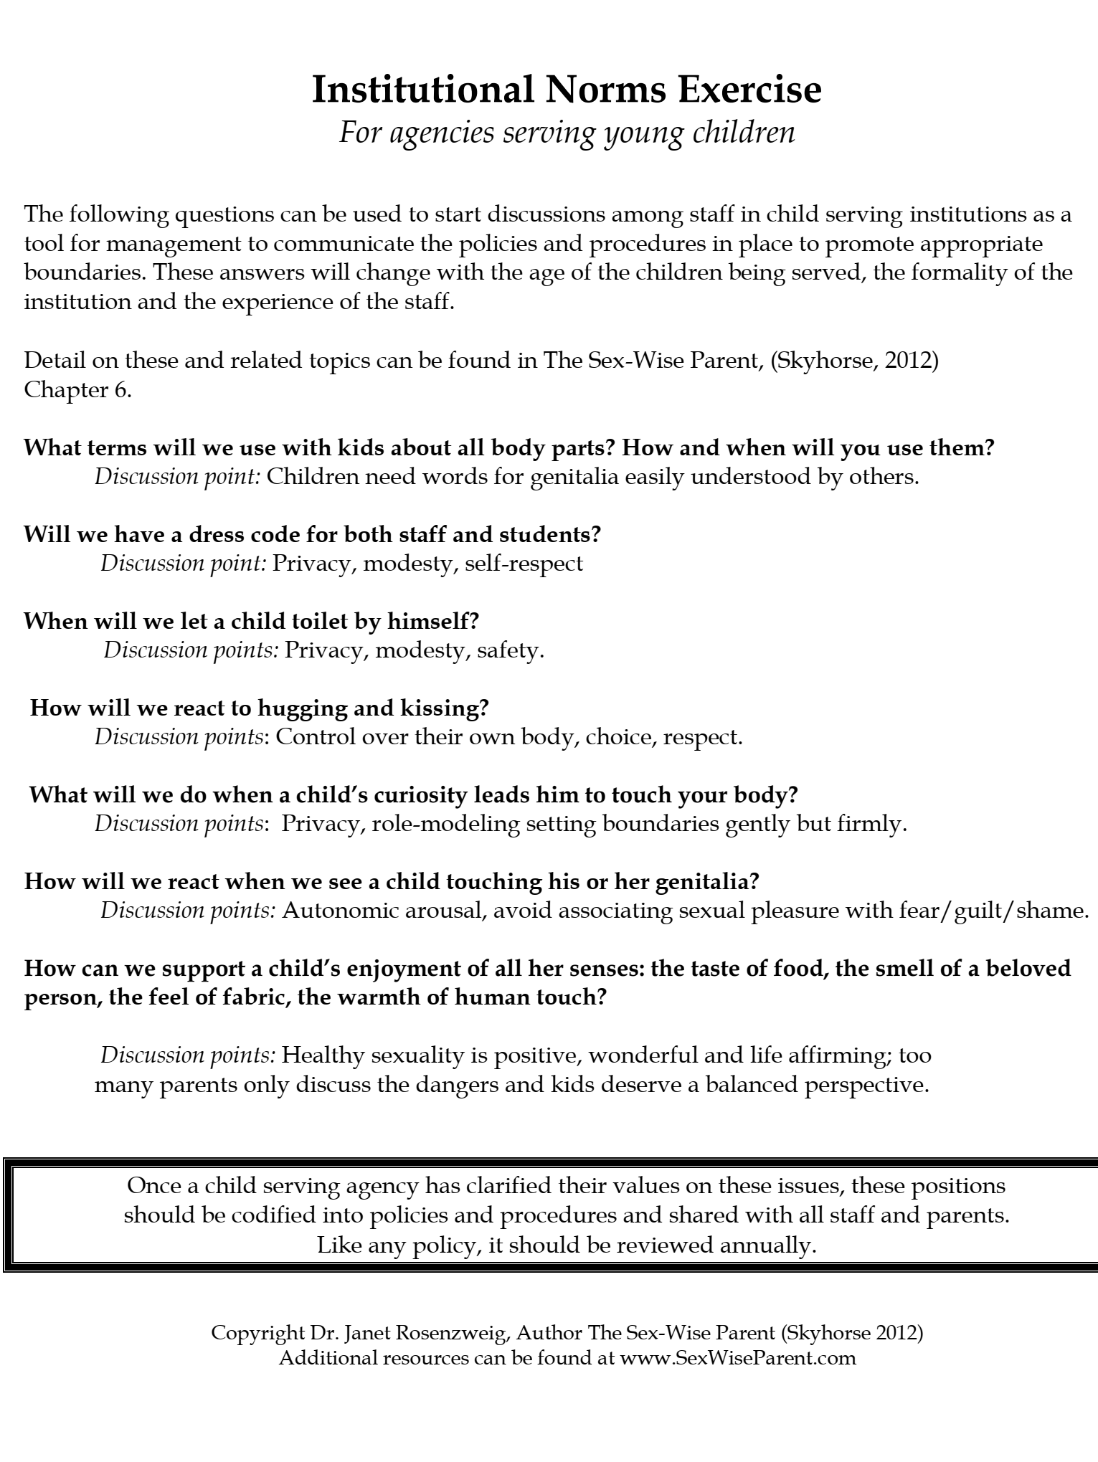
Notes:
Teachers and school personnel are hungry for this information! They know who the boundary ushers are…. What they don’t know is what to do about it…
Great new programs developed for school personnel…. Enough Abuse, D2l…

Slide 60
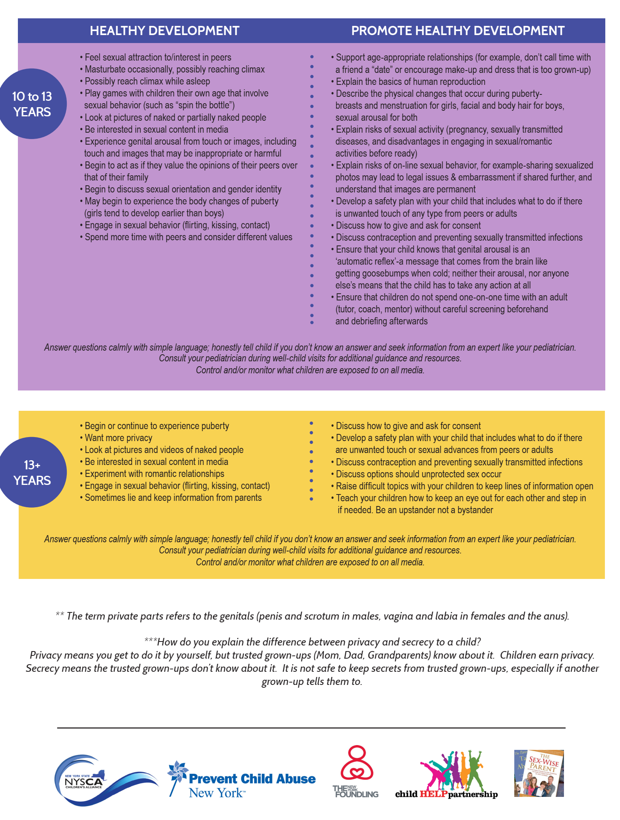

Slide 61


Slide 62
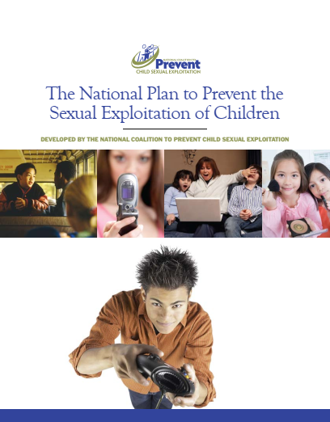
www.Preventtogether.com

Slide 63

For more Information and Resources
www.NYPreventSexAbuse.org/
New York State Initiative to Prevent Child Sexual Abuse
The Initiative is dedicated to the prevention of all forms of child sexual abuse throughout the state of New York through advancing research, policy, education and practice. We are organized as a cooperative initiative to provide state-of-the-art theory and research-based knowledge to inform, guide, and empower the public, professionals, and all those who serve children and families at all levels and sectors of society, toward the elimination of child sexual abuse. The Initiative is comprised of leaders in the field of child maltreatment, child protection, and promotion of well-being in children and families.
www.sexwiseparent.com

